Slide 1
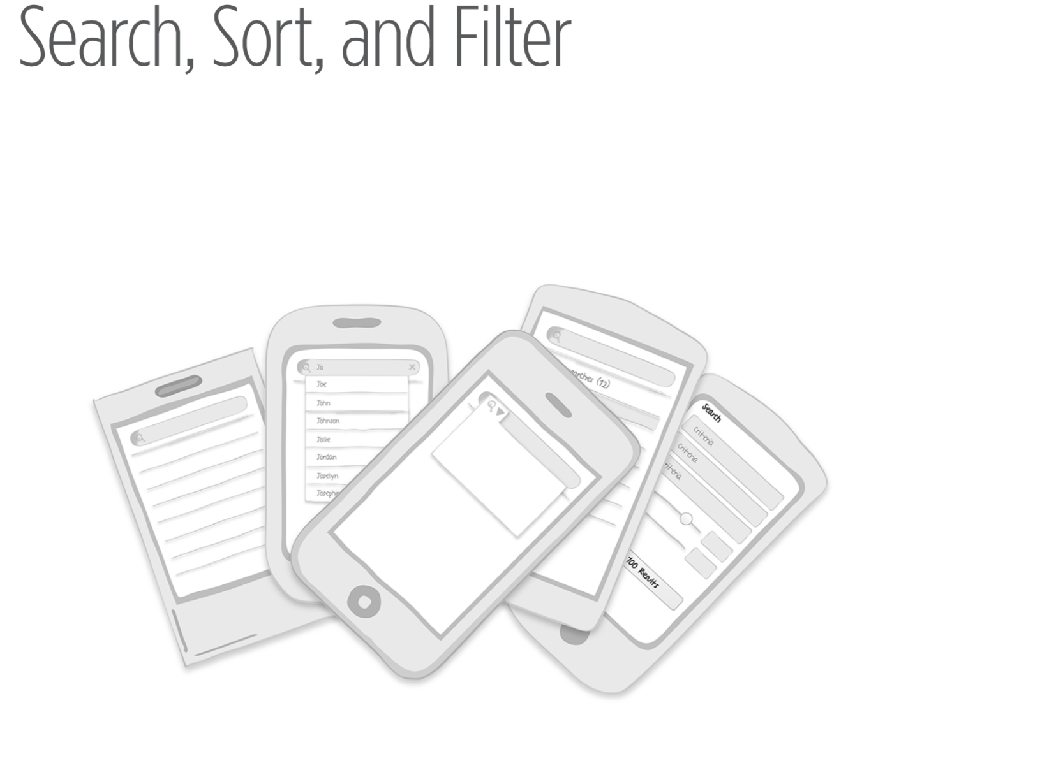
Notes:
Search Patterns
Implicit Search;
Explicit Search;
Auto-Complete;
Scoped Search;
Dynamic Search;
Saved, Recent,
and Popular;
Search Form;
Search Results
Sort Patterns
Onscreen Sort,
Sort Overlay,
Sort Form
Filter Patterns
Onscreen Filter,
Filter Overlay,
Filter Form,
Filter Drawer,
Gesture-Based Filter

Slide 2

Notes:
Look at AutoDirect, Greensheet, or a similar freebie print ad circular
You’ll see page after page of classified ads organized in very broad categories, like Trucks, Cars, and Appliance. You practically have to read the whole rag from beginning to end to see if there are any ads that interest you.
This should give you a new appreciation for three basic online tools: search, sort, and filter.

Slide 3
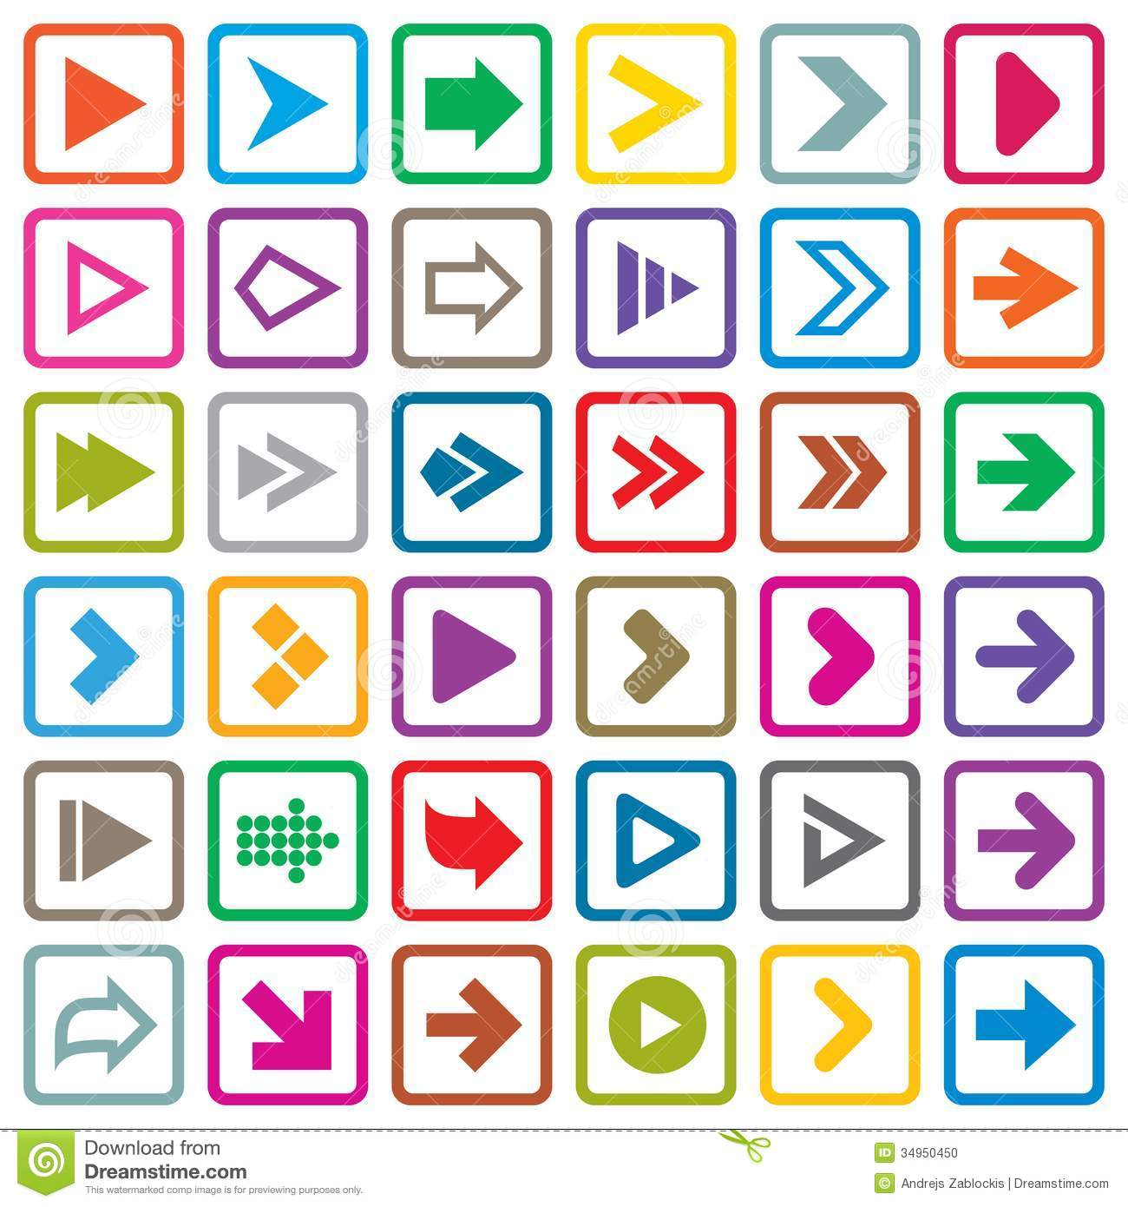
buttons are a hack
Notes:
We take them for granted in our digital world . But there are some nuances to getting search, sort, and filter right in a mobile application . This chapter explores more than a dozen different approaches .
Josh Clark, author of Tapworthy: Designing Great iPhone Apps (O’Reilly, 2010), says that in touch interface design, “buttons are a hack .” That’s because touch gives us more direct ways of interacting with content, like pull to refresh and pinch to zoom . Why use an abstract button when a physical gesture would be more intuitive?

Slide 4

YOU
Notes:
As our apps become more “aware” of our individual needs, they can reduce instances where we have to explicitly search for what’s relevant to us .
For instance, Google “knows” that I have a meeting downtown and tells me when to leave and how to get there . It also knows that I often take the kids to the movies on Saturday, so it “suggests” some shows at our favorite theater .
And when I am near a mall that has some of my favorite stores, RetailMeNot shows me all the deals they are running.
This emerging pattern is called Implicit Search.

Slide 5
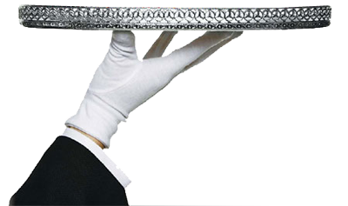
Implicit Search
Use available information to suggest answers.
Notes:
Implicit Search.
One night before I had a meeting with a new client, I Googled the client’s address on my PC . As I prepared to leave the next morning, I opened the new version of Google Maps and typed in the first number of the address, and Maps immediately knew where I wanted to go.

Slide 6
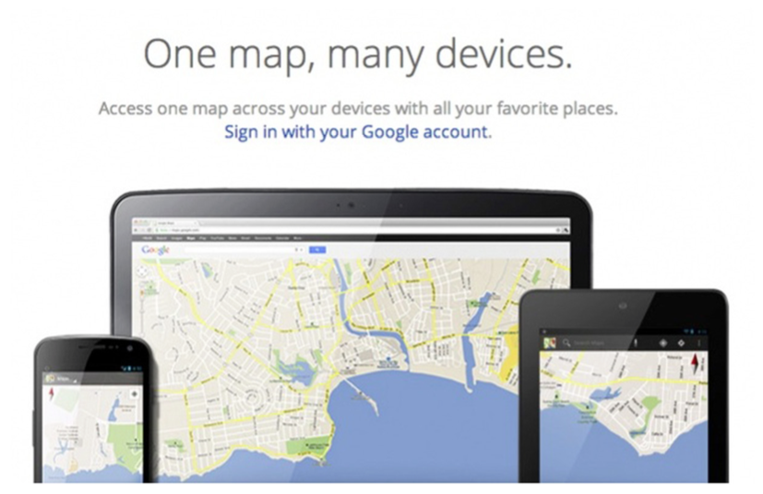
Notes:
With the new app, Google synchronized my information across channels and performed an Implicit Search for me . Wow, I thought, that was helpful .

Slide 7
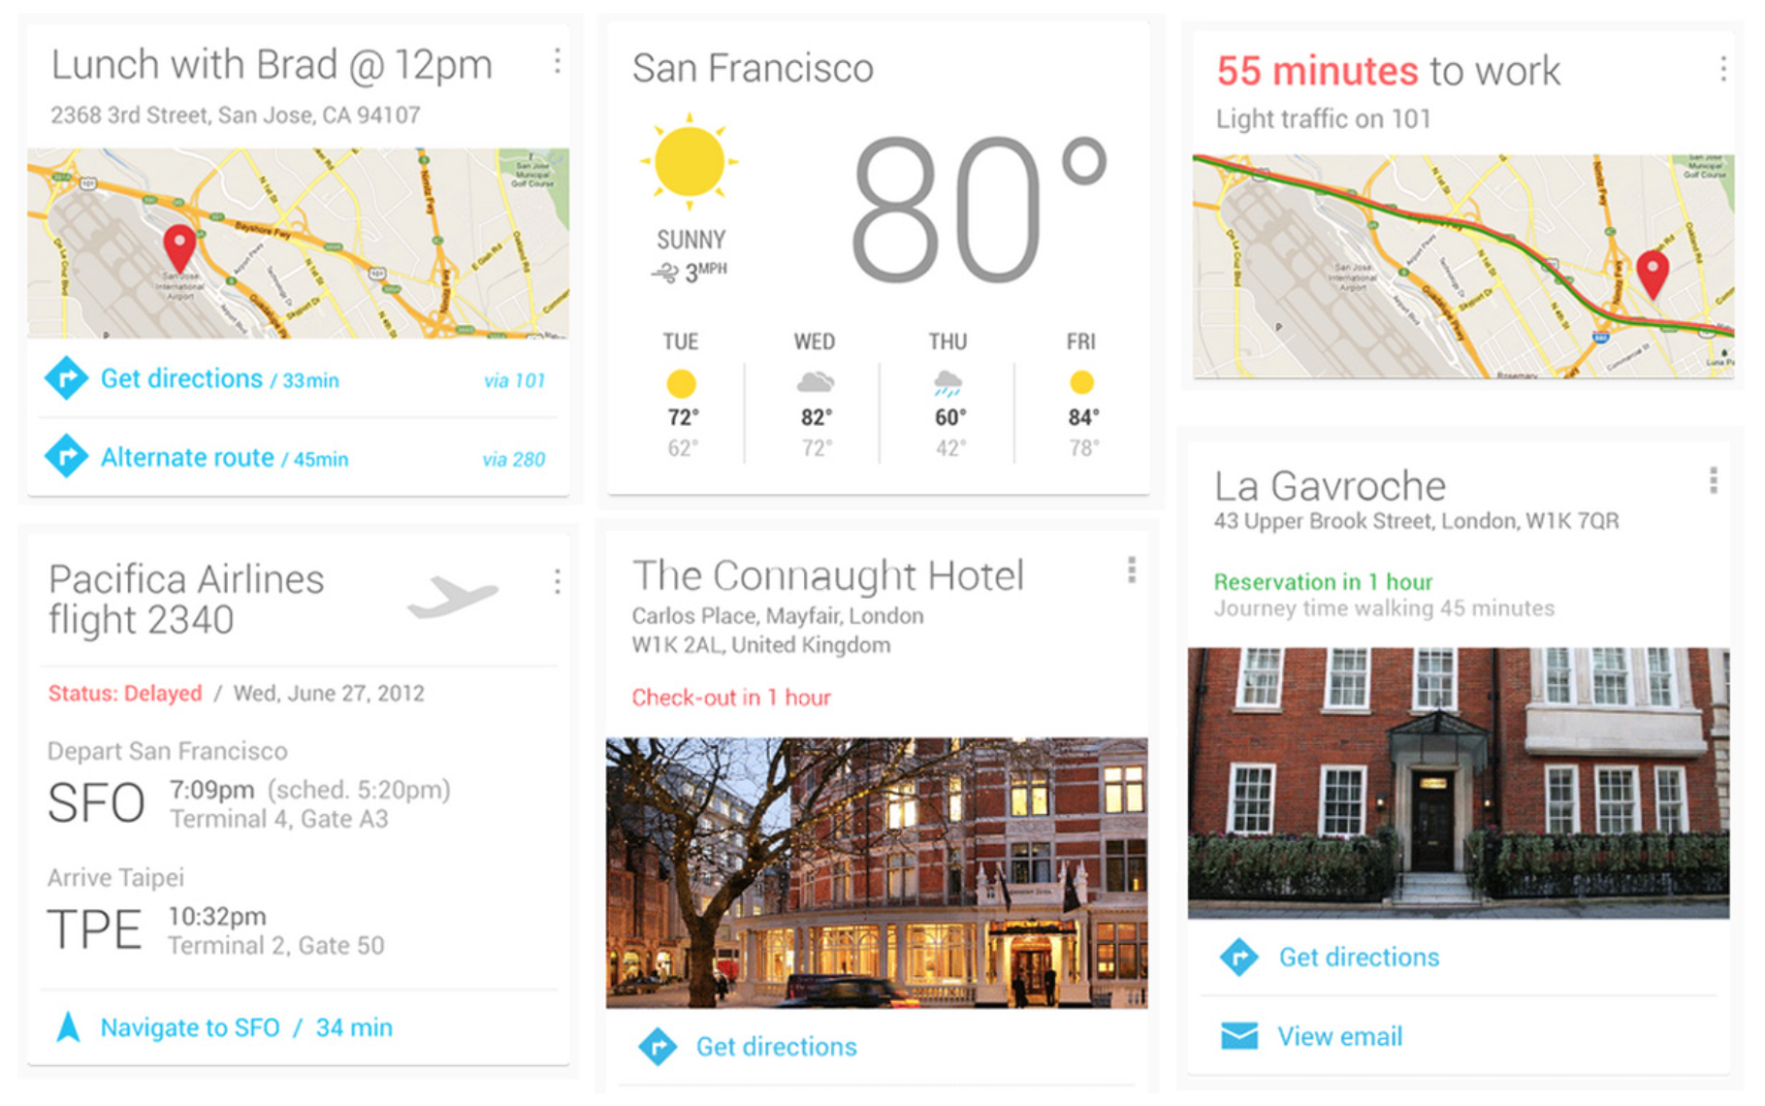
Notes:
But then Google Now really took Implicit Search to a new level, showing me where my following meeting was located, when I should leave, and how to get there . I rarely ever need to explicitly search in Google Maps now .
http://www.google.com/landing/now/

Slide 8
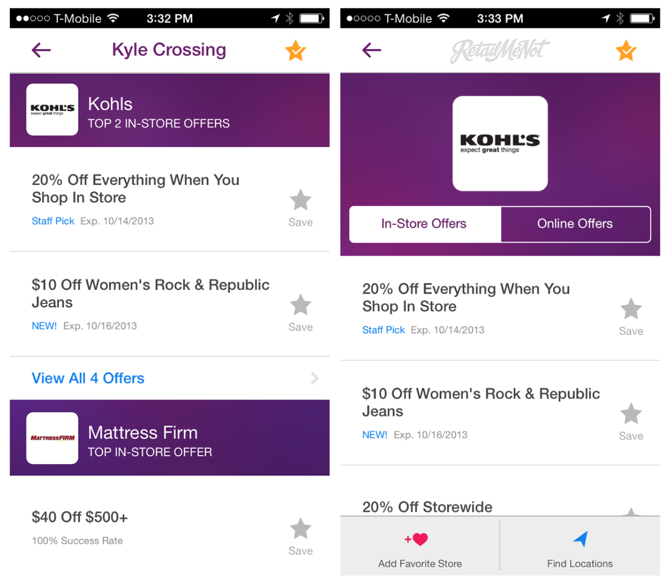
Notes:
RetailMeNot application signals “cha-ching” RetailMeNot sends a notification telling me that my favorite stores at the mall nearby were running some great deals . Once I was in a store, the app surfaced in-store coupons I could use to save on my purchase . This relevant information found me, without my having to look for it .

Slide 9
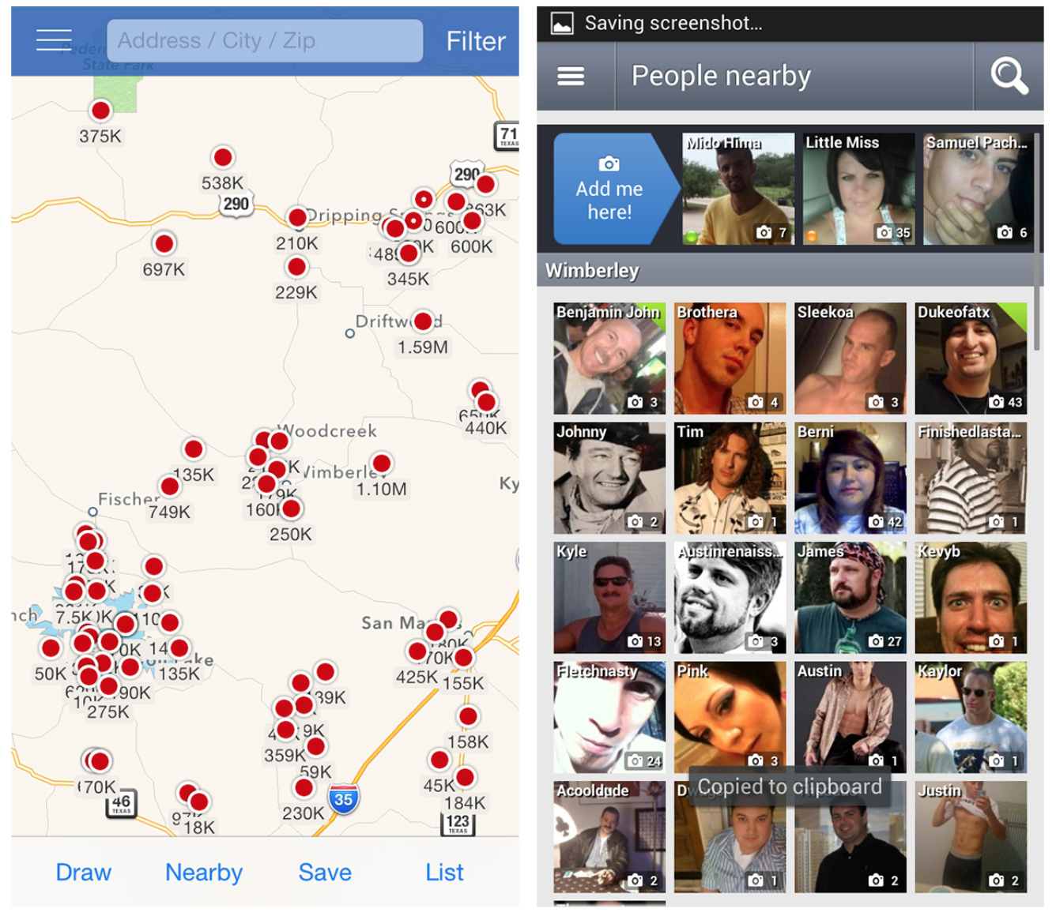
Notes:
If location-based services are enabled in Zillow and similar real estate apps, the apps immediately reveal all the properties for sale or rent in the area .
Badoo, a social meetup tool, uses the same technique to show nearby people looking to connect .

Slide 10
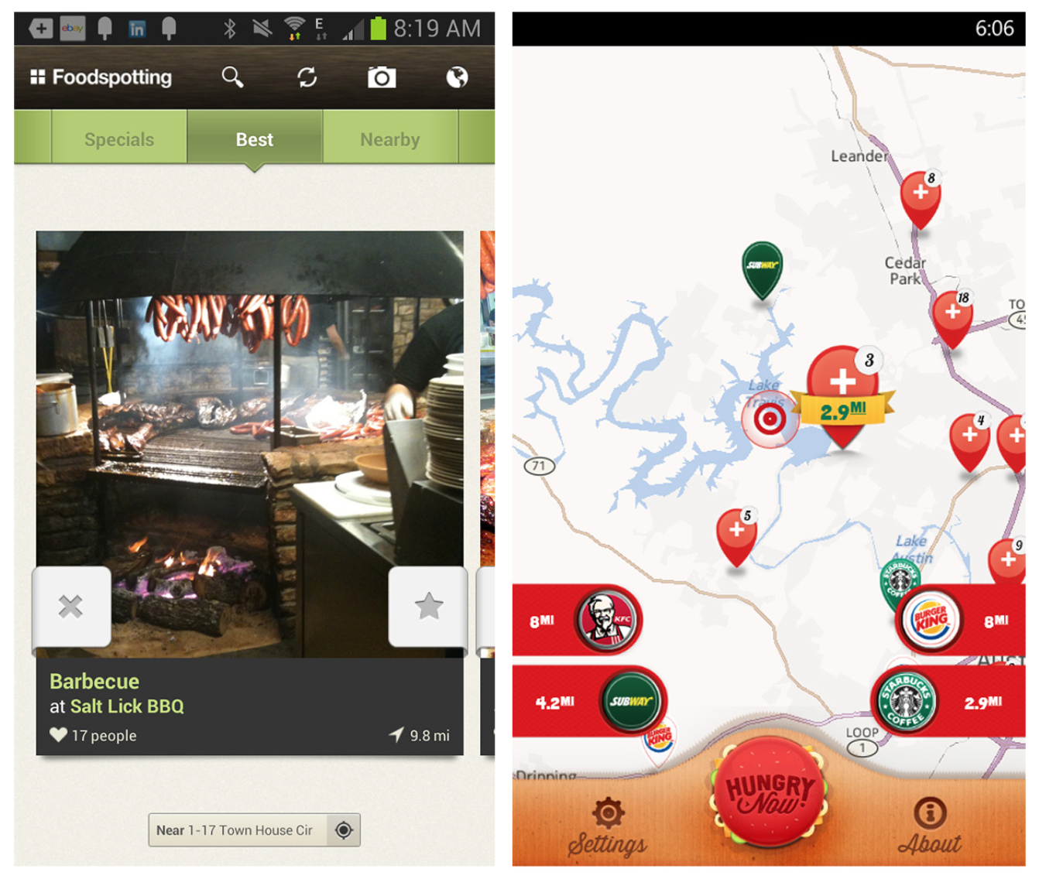
Notes:
Foodspotting and Hungry Now highlight nearby restaurants on their landing pages.
Foodspotting uses a carousel to show pictures and details about each restaurant, encouraging the user to start rating her dining experiences,
whereas Hungry Now shows the restaurants on a map.

Slide 11
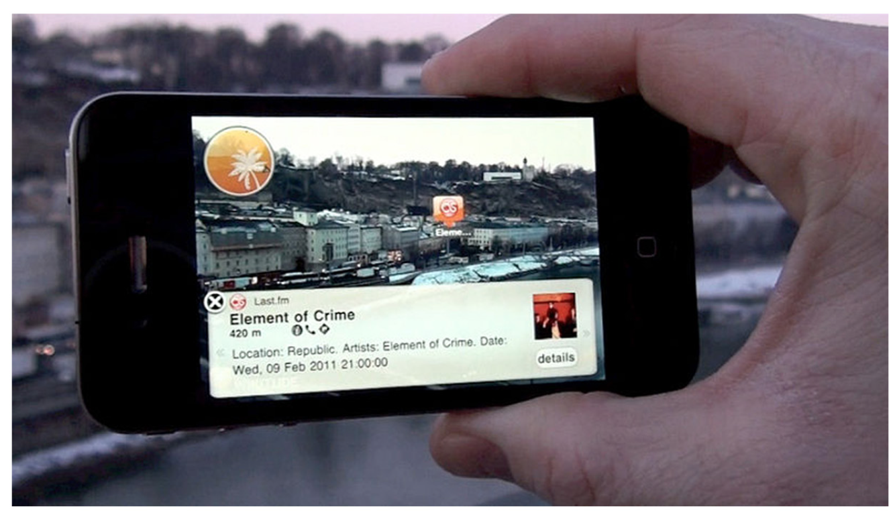
use a combination of the device’s location and the accelerometer to create an “augmented reality” for the user
no search terms necessary.
Notes:
Accelerometer
The accelerometer is a built-in electronic component that measures tilt and motion. It is also capable of detecting rotation and motion gestures such as swinging or shaking.
The most common use for it is to activate auto screen rotation on mobile devices when the user changes their orientation from portrait to landscape or vice-versa.
Another modern application for the accelerometer is to control the mobile device music player with gestures (Sony Ericsson Shake control or Samsung Motion play technologies).
Accelerometers are also utilized for enriching the gaming controls (navigating by tilting the device instead of by pressing keys).
Another popular mobile phone feature based on an accelerometer is turn-to-mute. It allows user to mute an incoming call, silence an alarm or pause the mobile music player simply by turning the device face down.

Slide 12
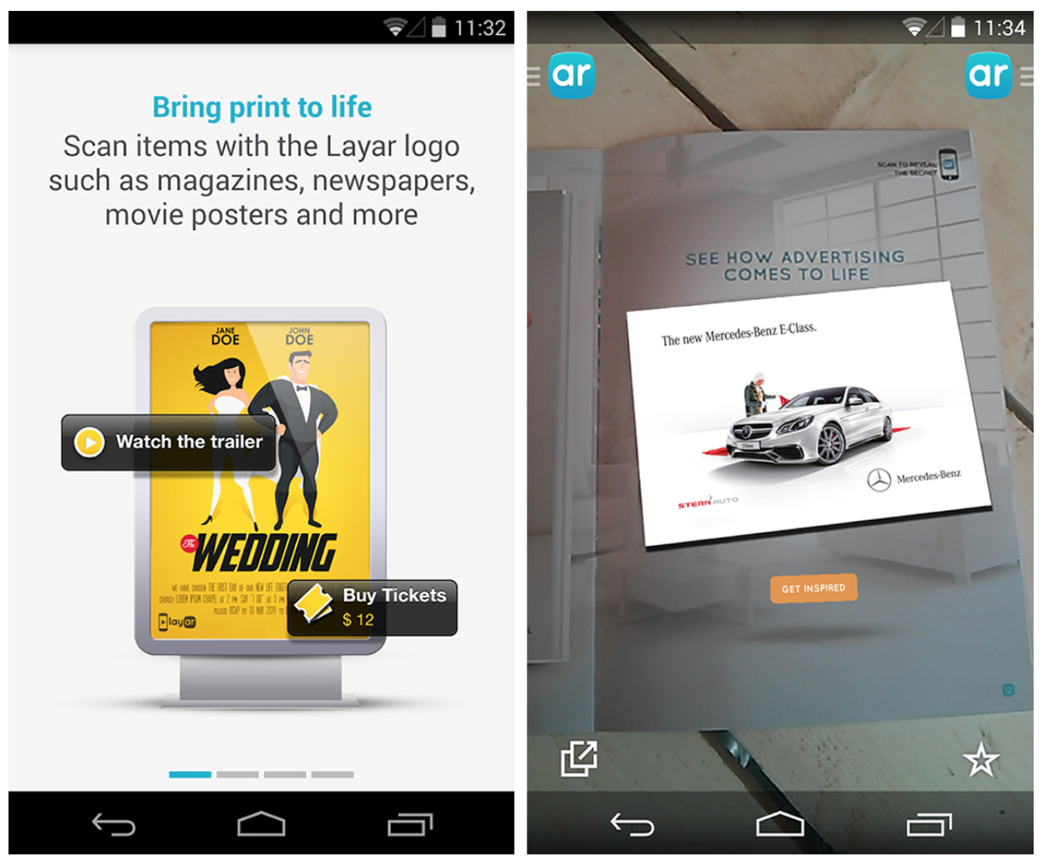
Notes:
another way to use augmented reality for Implicit Search

Slide 13
Explicit Search
While Implicit Search can create richer user experiences, there are still valid cases for the Explicit Search pattern.
Explicit Search relies on explicit user action to perform the search and get results.

Slide 14
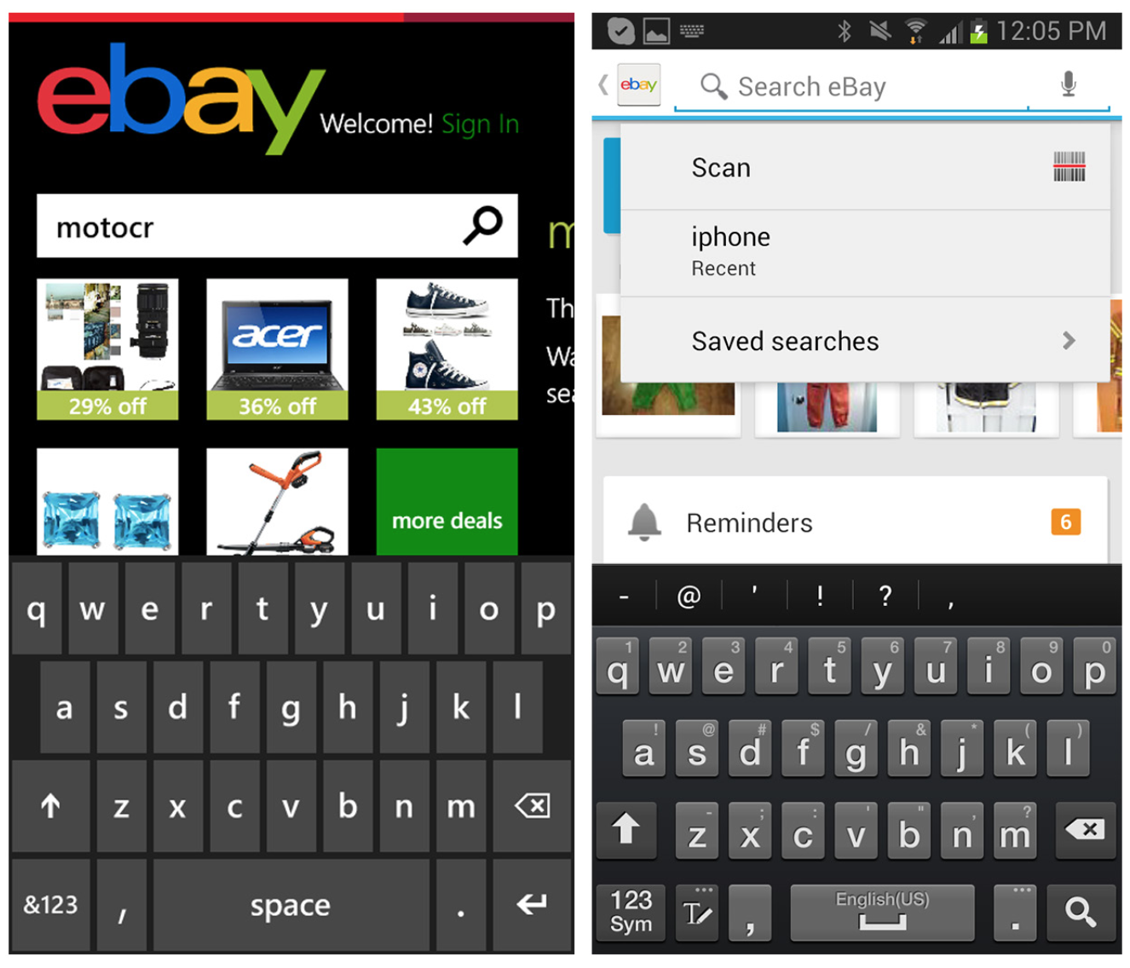
Notes:
The eBay app on Windows Phone 8 is a simple example . Type the search term, then tap on the search icon or hit Return on the keyboard to see the results . But by being just a little smarter, eBay for Android manages to be a lot more helpful .
Tapping in the search field in the Android app provides a number of options: scan an item instead of typing it, reuse a recent search, or access saved searches . Once the user starts typing, the app surfaces suggestions that match the text entered . Minimizing the need to type in this way increases search efficiency and reduces the chance of error . Also see the next pattern, Search with Auto-Complete .
FIGURE 4-8.
eBay for Windows Phone and Android

Slide 15
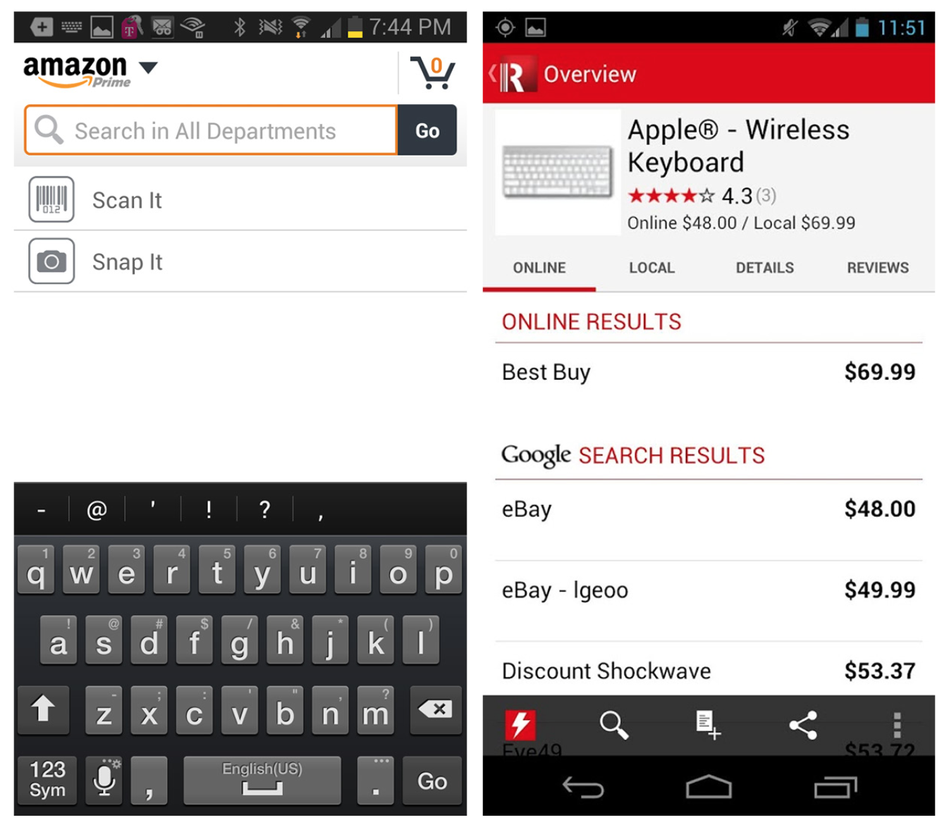
Notes:
As eBay for Android suggests, Explicit Search needn’t be confined to text entry . Amazon and RedLaser offer photo and barcode scanning options for quick in-store lookups. These mobile-friendly search features have helped drive the showrooming phenomenon (http:// en .wikipedia.org/wiki/Showrooming) that has changed the retail shopping dynamic in recent years.
FIGURE 4-9.
Amazon and RedLaser for Android: Explicit Search via barcode scanning

Slide 16
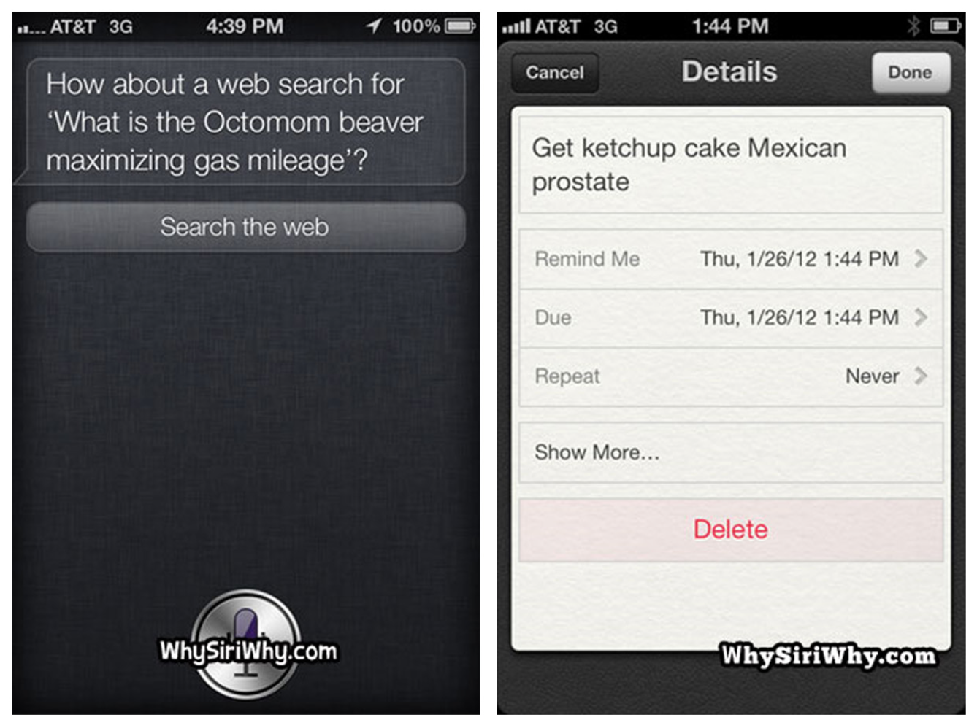
Notes:
Voice-based search also can be useful, but it is dependent on the quality of the voice recognition program. We’ve all heard funny stories of Siri wildly misunderstanding user questions (see the screenshots from WhySiriWhy.com), but voice search has already come a long way, and I expect its refinement to continue.
FIGURE 4-10.
WhySiriWhy.com: a site devoted to voice searches gone wrong

Slide 17
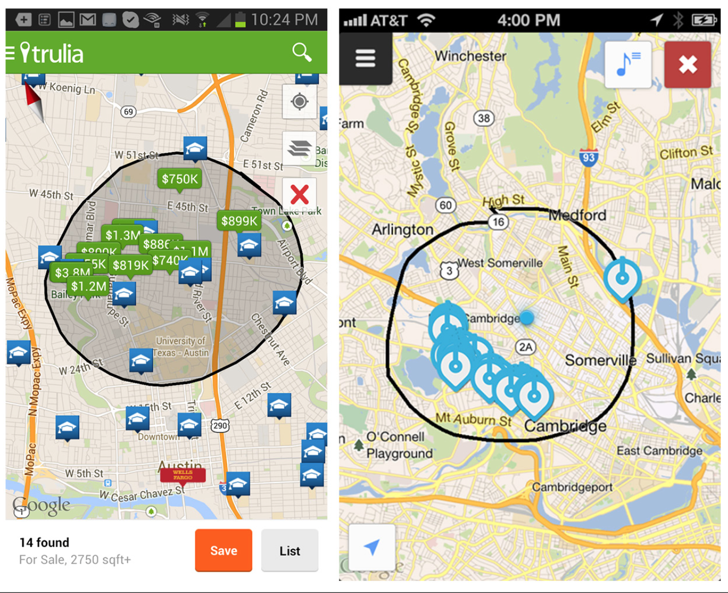
Notes:
Another option for Explicit Search is via direct manipulation . Trulia and Soundwave both offer options to physically draw search boundaries on a map .
FIGURE 4-11.
Trulia for Android and Soundwave for iOS use gestures to draw search boundaries

Slide 18
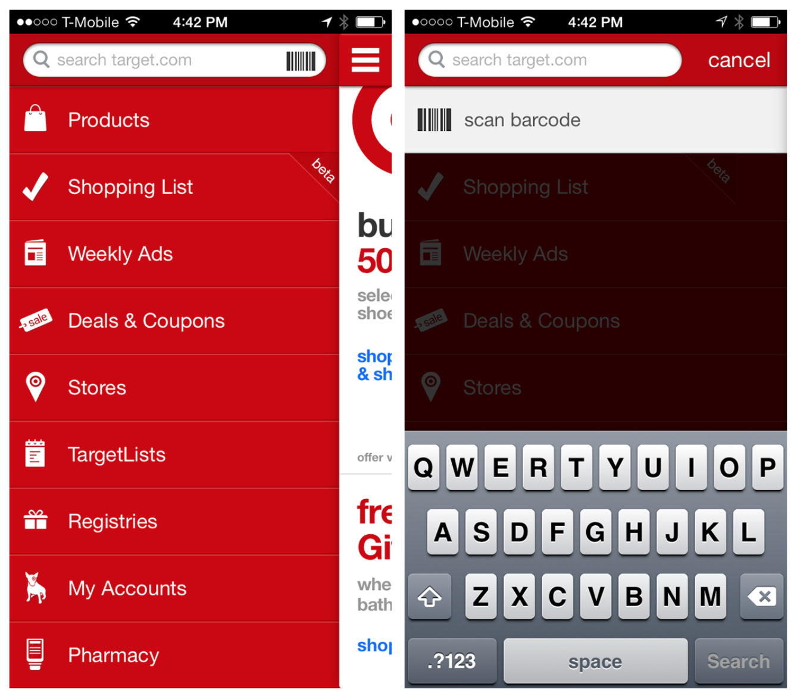
Notes:
One more emerging pattern in Explicit Search is Modal Search. In this example from Target, the search field is shown in the navigation drawer, but as soon as it is tapped, “search mode” displays a full search screen with keyboard.
FIGURE 4-12.
Target for iOS: tapping on the search field opens a new search screen

Slide 19
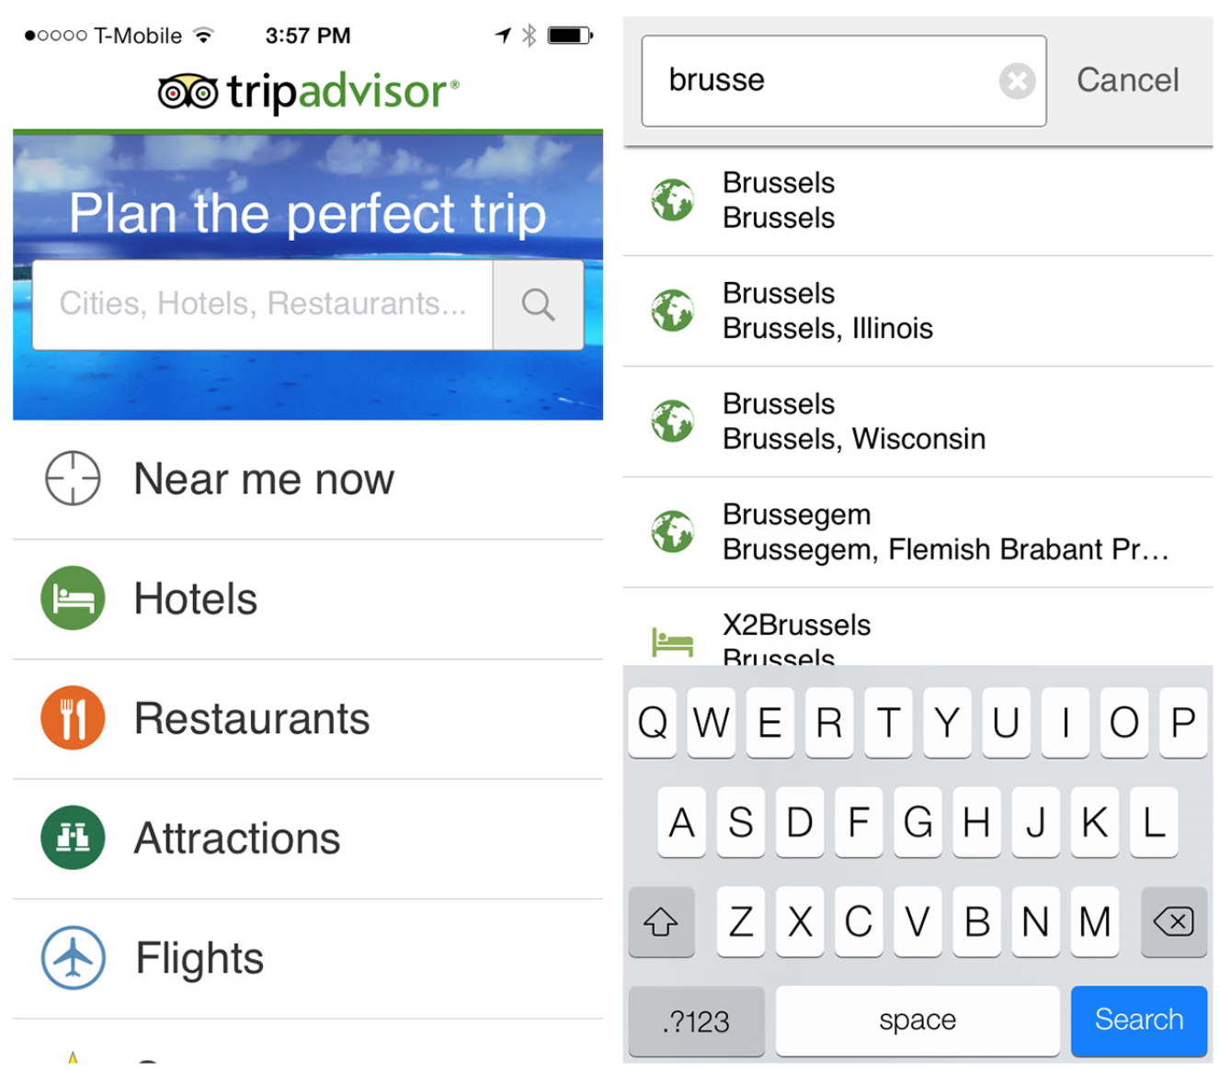
Notes:
FIGURE 4-13.
TripAdvisor for iOS: Modal Search slides a search screen in from the right

Slide 20
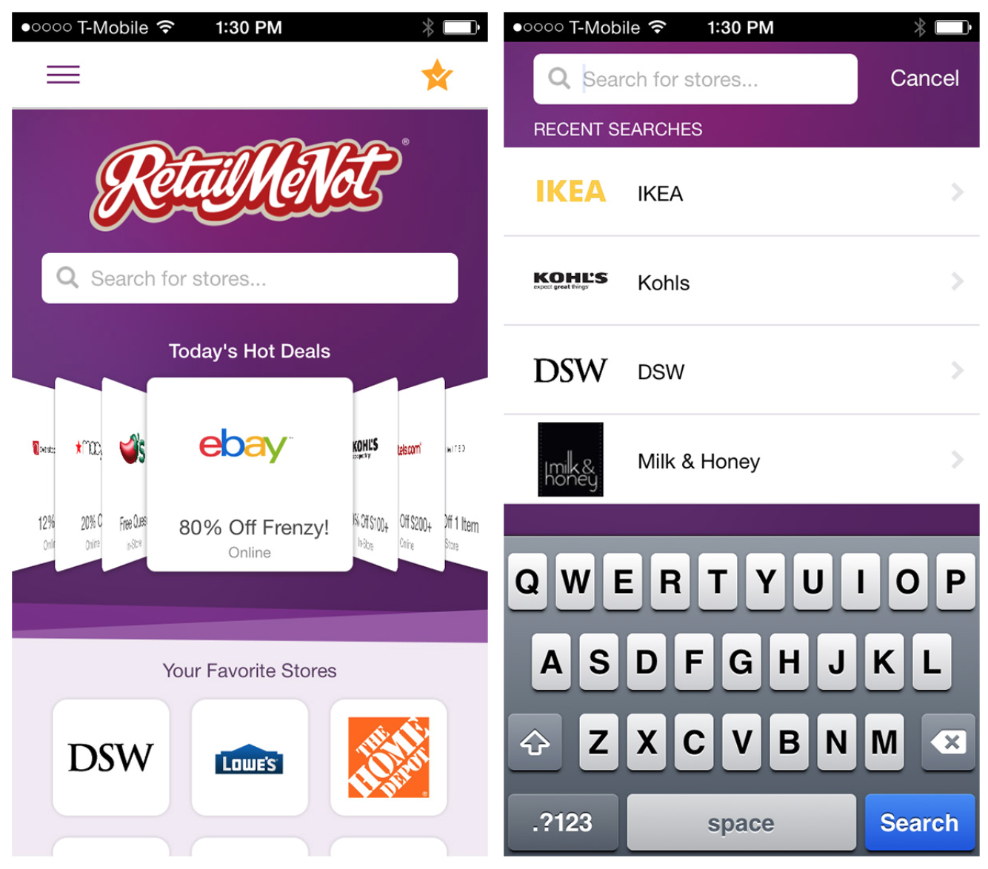
Notes:
FIGURE 4-14.
RetailMeNot for iOS: the Modal Search screen slides up
The main benefit of Modal Search is the additional real estate the full search screen offers. Just remember to offer a way back (e .g ., Cancel) for users who decide not to search after all .

Slide 21
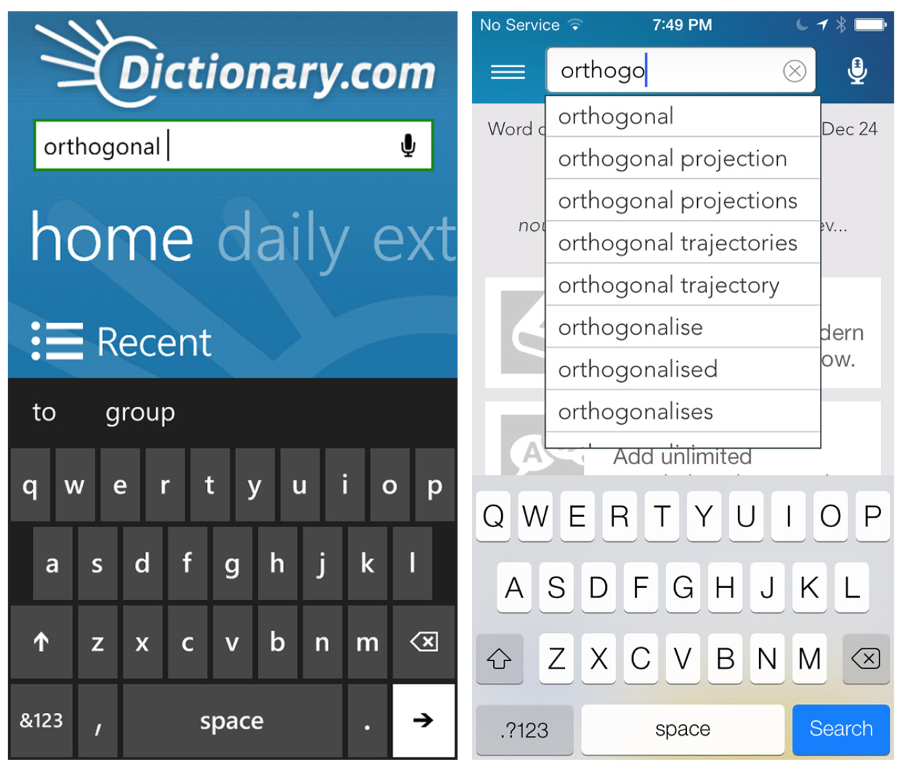
Auto-Complete
Notes:
At this stage in mobile design’s maturity, Auto-Complete should be standard for Explicit Search. I was stunned that fewer than 10% of the Windows Phone 8 apps I researched had this functionality, even though these design patterns have been around since 2004 on the Web, and even longer on desktop. Shockingly, even Dictionary.com on Windows Phone doesn’t offer Auto-Complete, and who needs it more than someone using a dictionary app?
Dictionary.com for Windows Phone and iOS: Auto-Complete should be standard

Slide 22
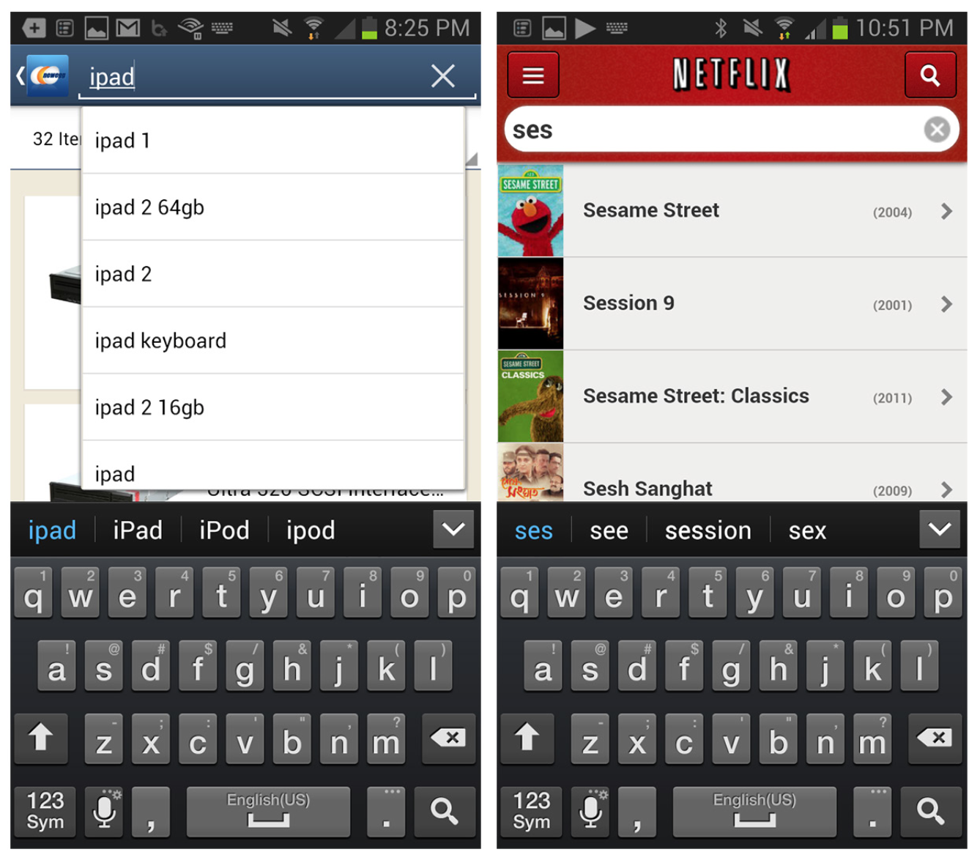
Notes:
Auto-Complete should be implemented so that as text is entered, a set of possible results surfaces.
As the user continues to enter text, the search results narrow accordingly.
A tap on any result initiates the search. Tapping a button (on the screen or keyboard) should also be an option to initiate search on the currently highlighted result.
Ideally, Auto-Complete results will display immediately, but a progress indicator (“Searching...”) should be used to give feedback. Fidelity displays feedback where the results will eventually be displayed.

Slide 23
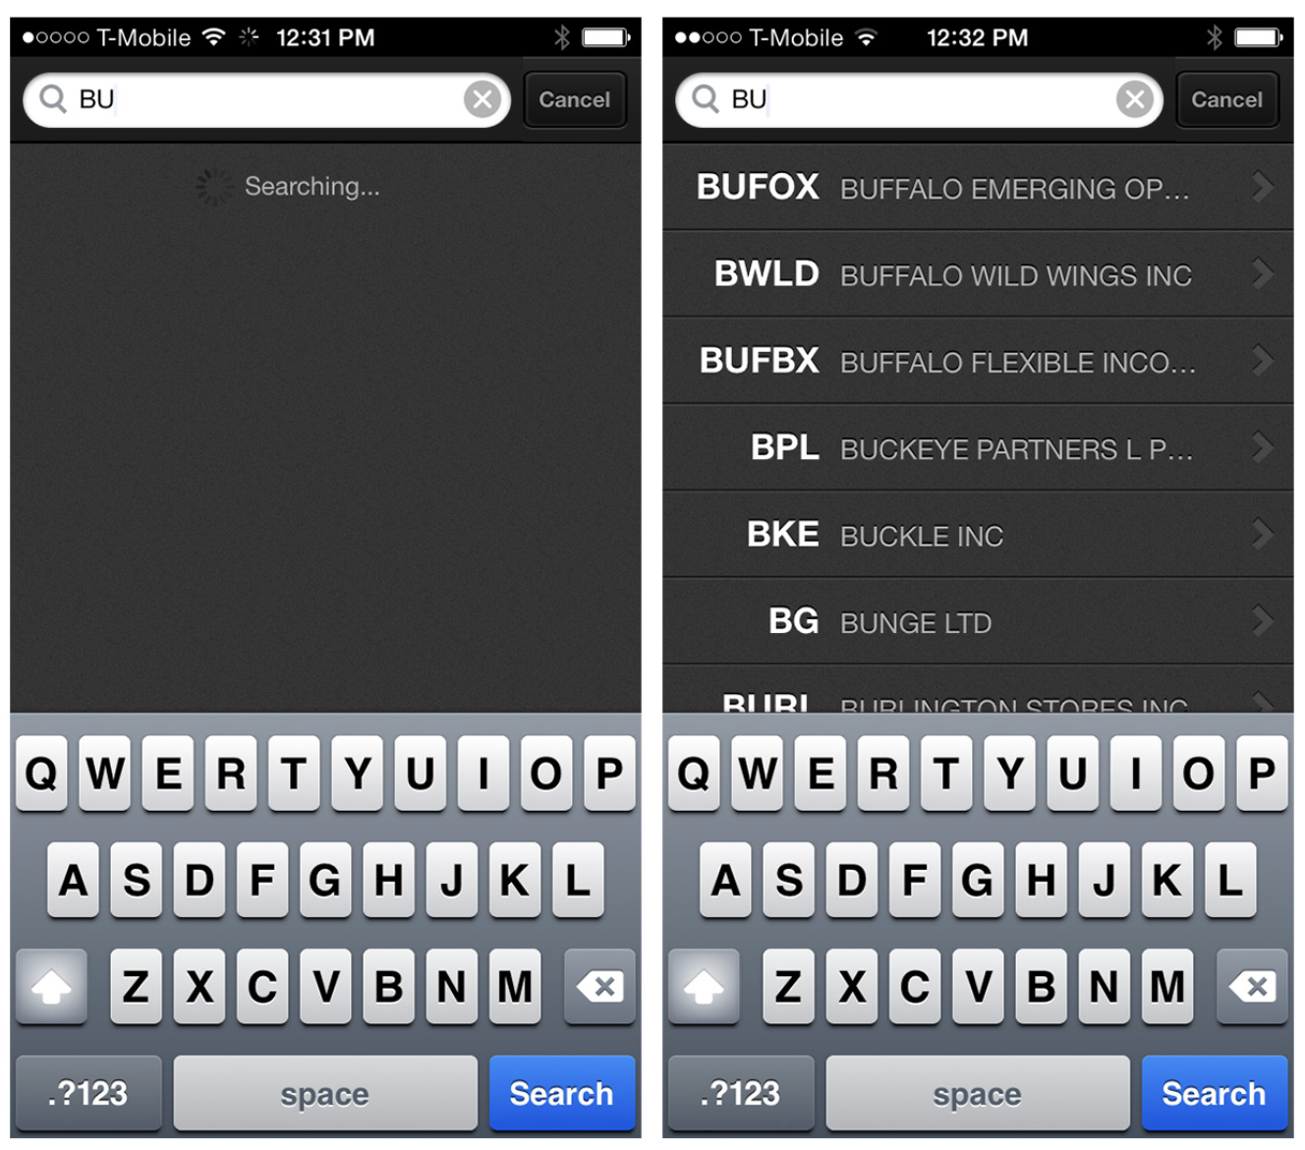
Notes:
FIGURE 4-17.
Fidelity for iOS provides feedback for Auto-Complete progress below the search field

Slide 24
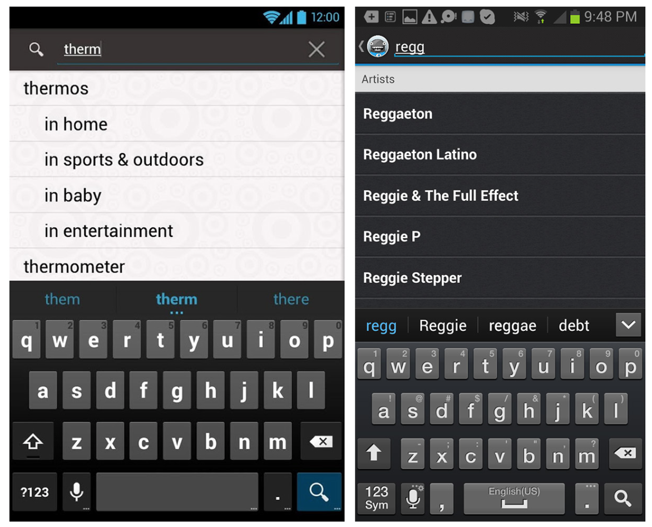
Notes:
Target’s Android app provides an enhanced Auto-Complete that shows the possible categories for each suggestion.
This makes it easier for users to navigate directly to the most relevant search results.
Songza also has an enhanced Auto-Complete that shows groupings.
FIGURE 4-18.
Target and Songza for Android: enhanced Auto-Complete options

Slide 25
Dynamic Search
The Dynamic Search pattern may also be considered dynamic filtering.
Here, a blank search field returns all possible category results, and entering a search string dynamically filters down the list.

Slide 26
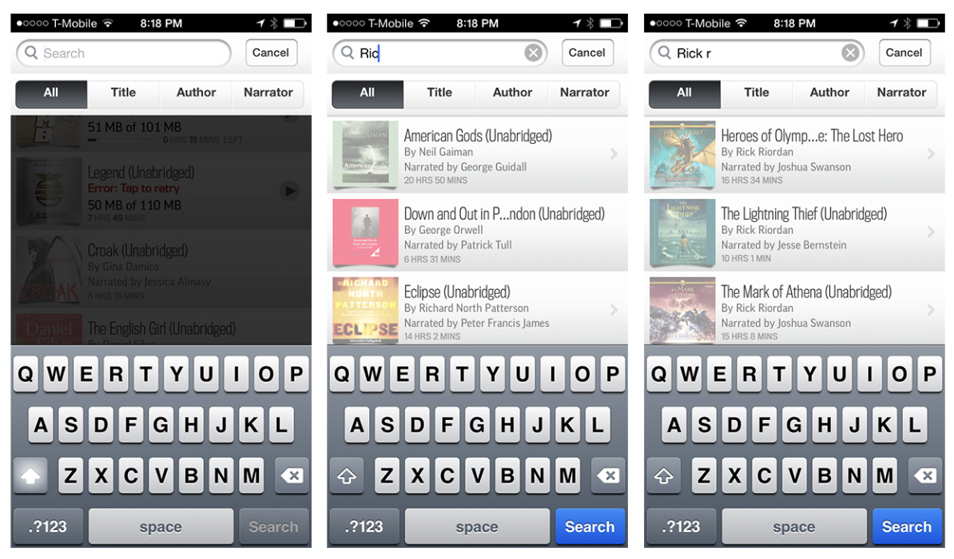
Notes:
In the Audible example, you can see that my entire audiobook library is shown in the background. When I start to type, only the matching titles remain.
FIGURE 4-19.
Dynamic Search in Audible for iOS narrows results as users type.

Slide 27
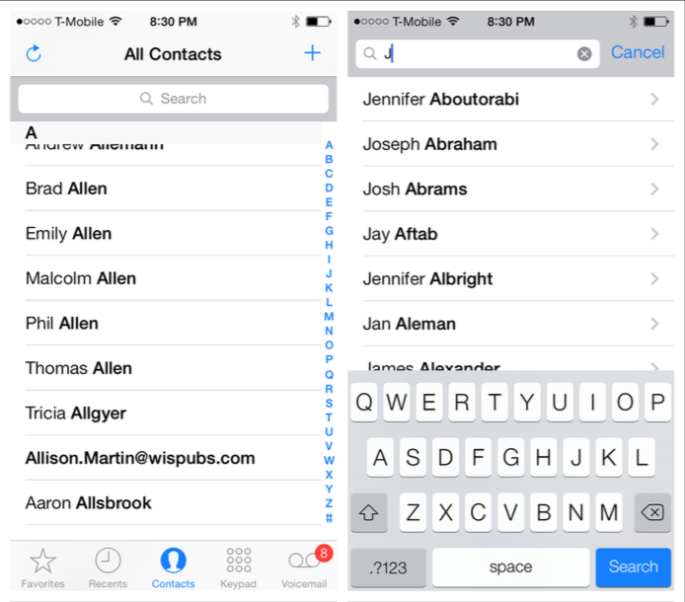
Notes:
FIGURE 4-20.
Dynamic Search in Contacts for iOS quickly winnows results of search

Slide 28
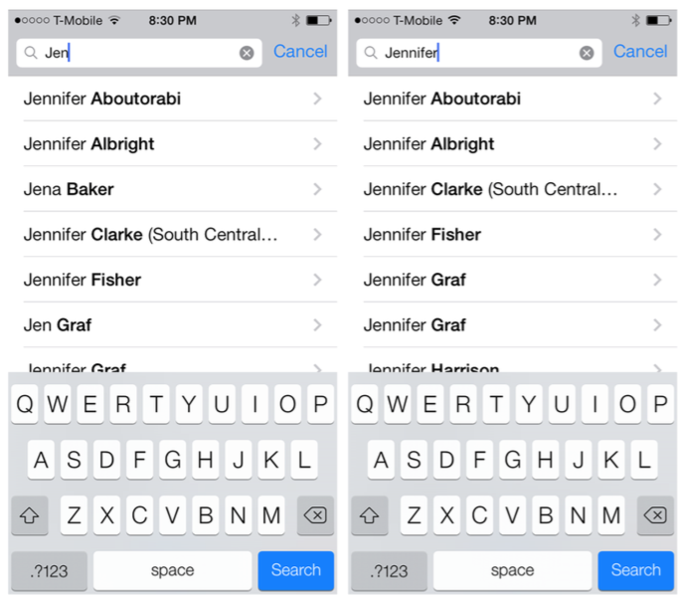
Notes:
Dynamic Search works well for constrained data sets, like an address book or a personal media library,
but it should not be used for searching huge data sets, like a retailer’s inventory.

Slide 29
Scoped Search
Sometimes users can get search results faster and easier if you let them narrow the scope of the search before they actually initiate it.
Google on Windows Phone 8 offers a menu for specifying a category, while the Google Play Store for Android uses a Spinner control nestled under the search field.

Slide 30
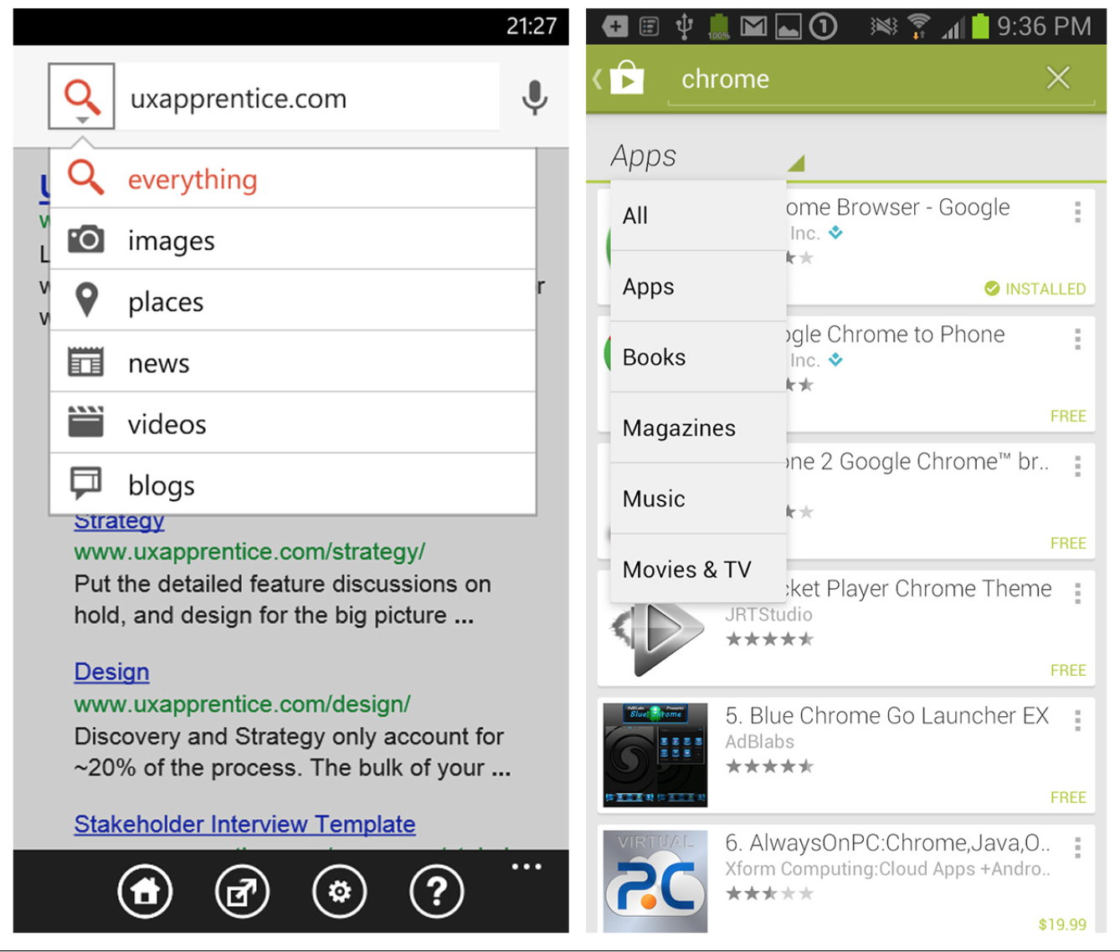
Notes:
FIGURE 4-21.
Google for Windows Phone and Google Play Store for Android: menus to scope searches
It is common to see a segmented control in iOS for Scoped Search, as in iTunes, but there are other UI options, like Scrolling Tabs or a Pill Bar .

Slide 31
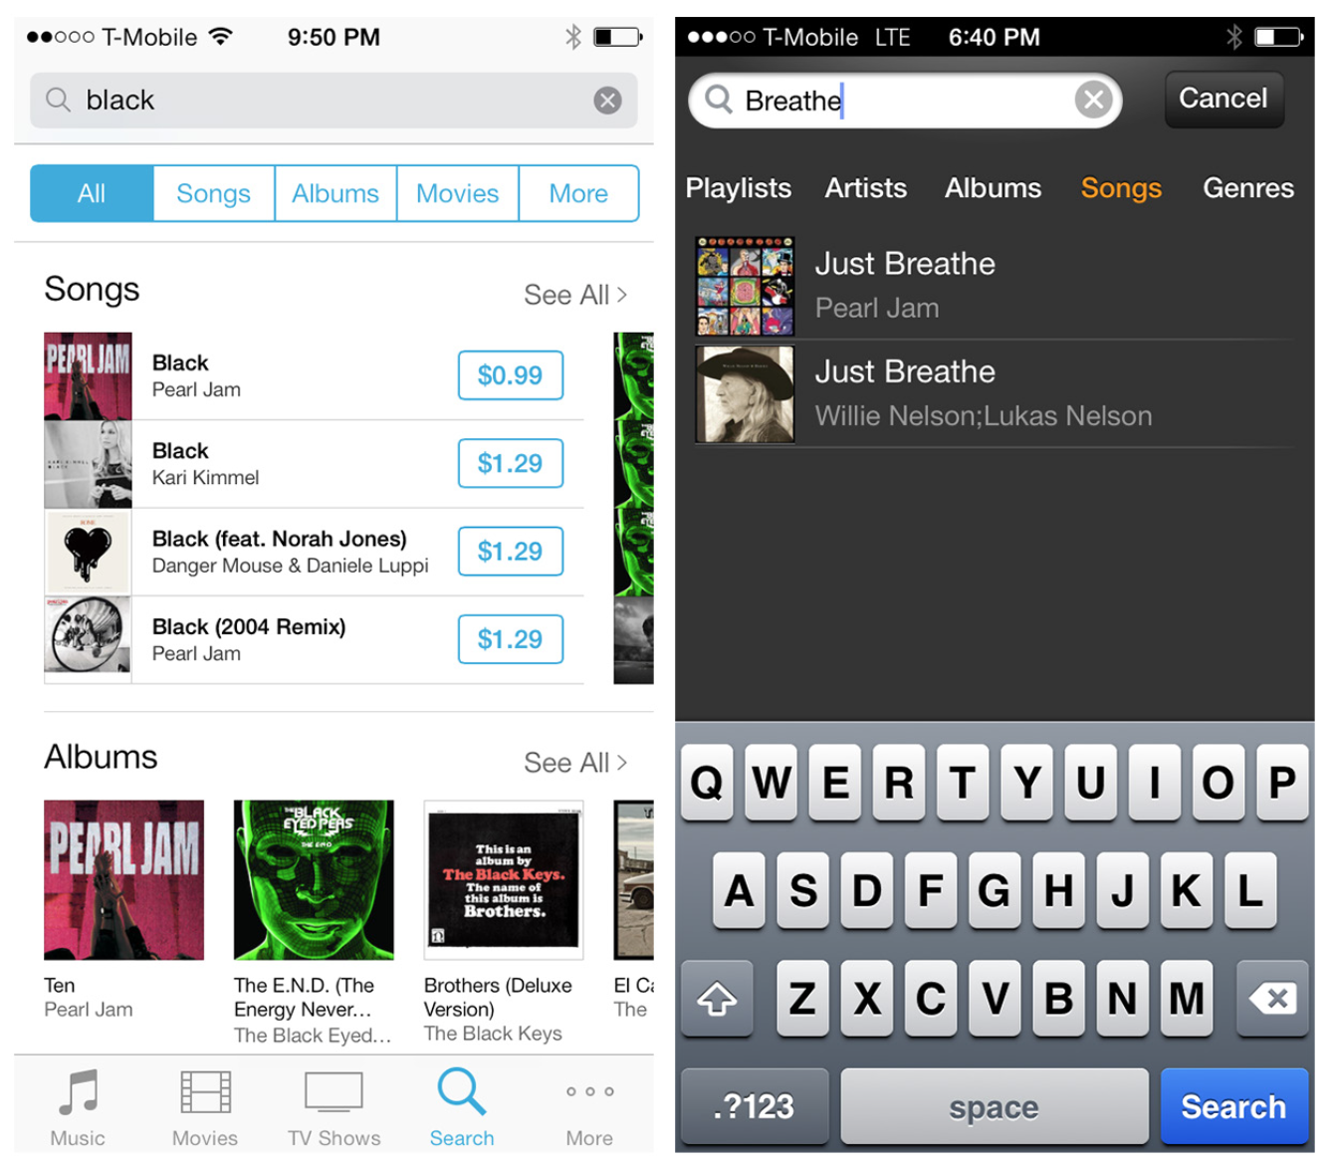
Notes:
Offer reasonable scoping options based on the data set. Three to five scoping options is plenty. Consider a Search Form to provide advanced search capabilities.
FIGURE 4-22.
iTunes and Amazon Cloud Player for iOS: two options to narrow search scope

Slide 32
Saved, Recent, and Popular Search
Well-designed mobile interfaces follow a basic usability maxim: respect the user’s effort.
Saved, Recent, and Popular Searches do this by making it easy to select from previous searches instead of retyping the same keywords or search criteria.

Slide 33
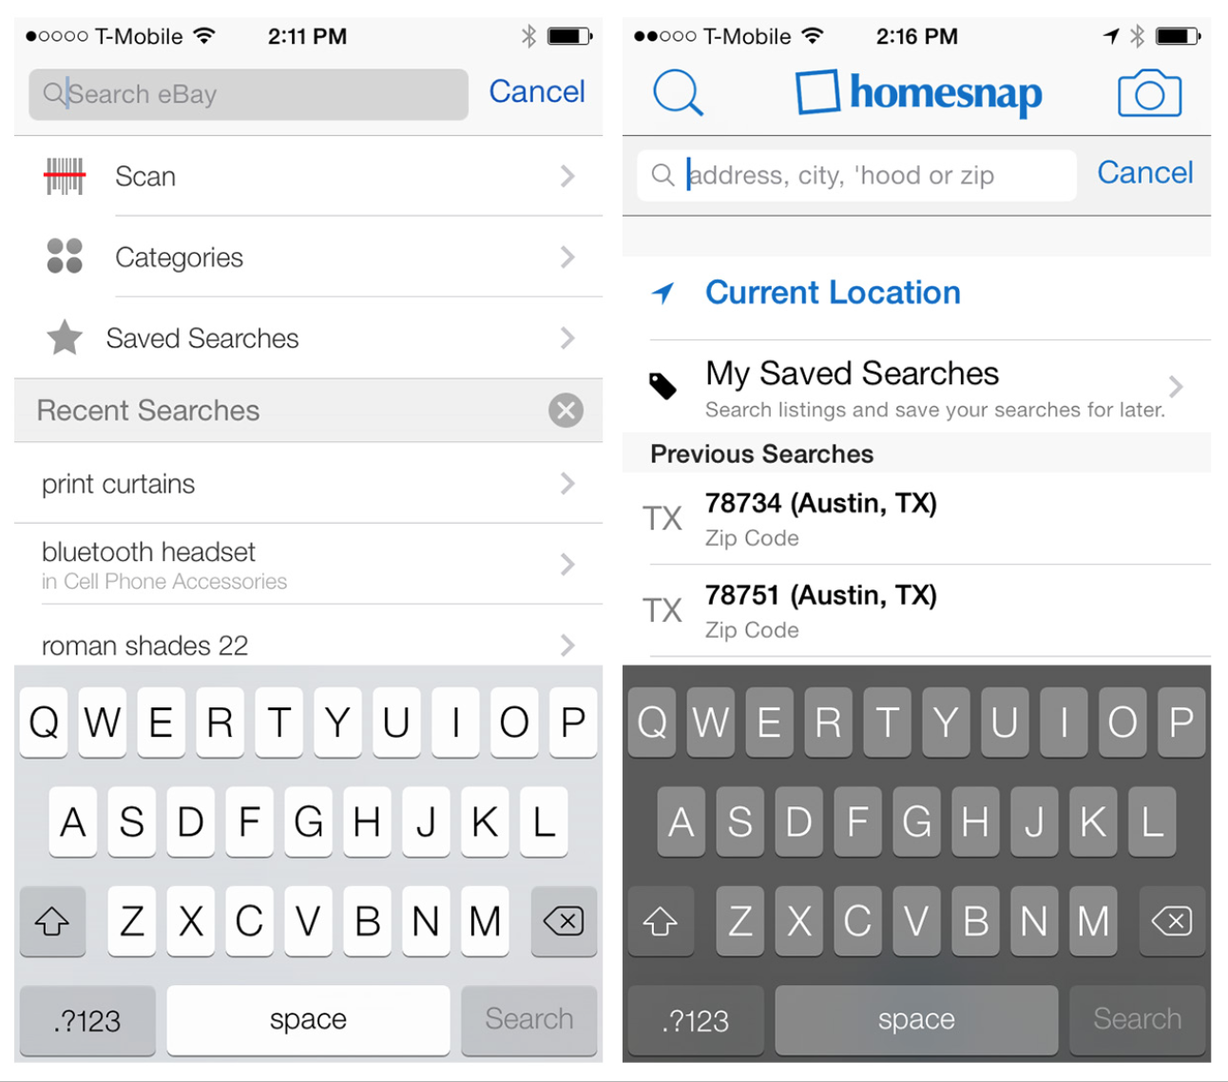
Notes:
FIGURE 4-23.
eBay and homesnap for iOS: Saved and Recent Searches

Slide 34
Notes:
FIGURE 4-24
Groupon and CheckPay surface users’ most popular searches and most popular search options, respectively .

Slide 35
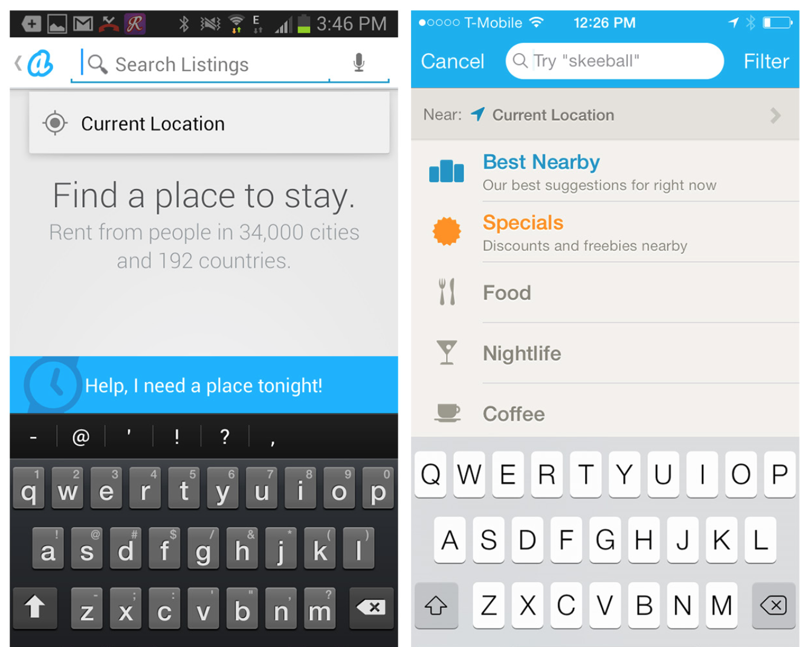
Notes:
Other techniques to respect the user’s effort include location-based searching, as in Airbnb and Foursquare.
FIGURE 4-25.
Airbnb for Android and Foursquare for iOS: location-based searching

Slide 36
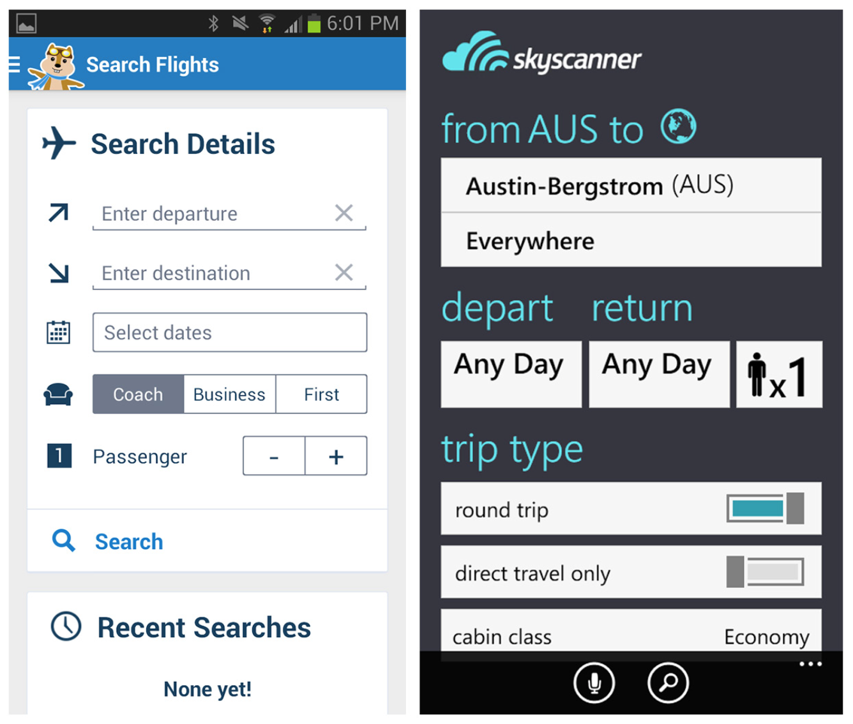
Search Form
This pattern is characterized by a separate form for entering multiple criteria, along with an explicit search button.
Notes:
Hipmunk and Skyscanner use Search Forms to set the necessary criteria for searching flights and hotels. See Chapter 2.
Minimize the number of input fields. Use OS-specific input controls properly.
Follow form design best practices for alignment, labels, size, and so on.

Slide 37
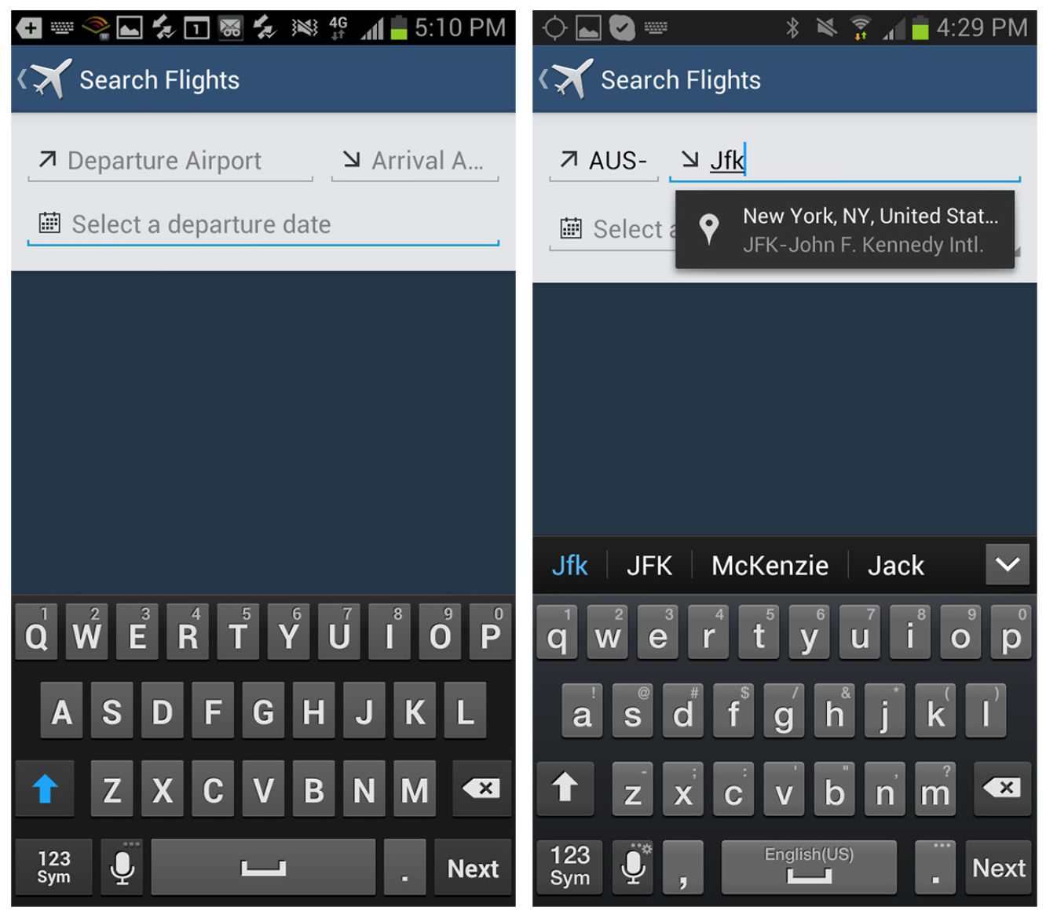
Notes:
FIGURE 4-27.
Expedia for Android: a helpful, elegant Search Form design

Slide 38
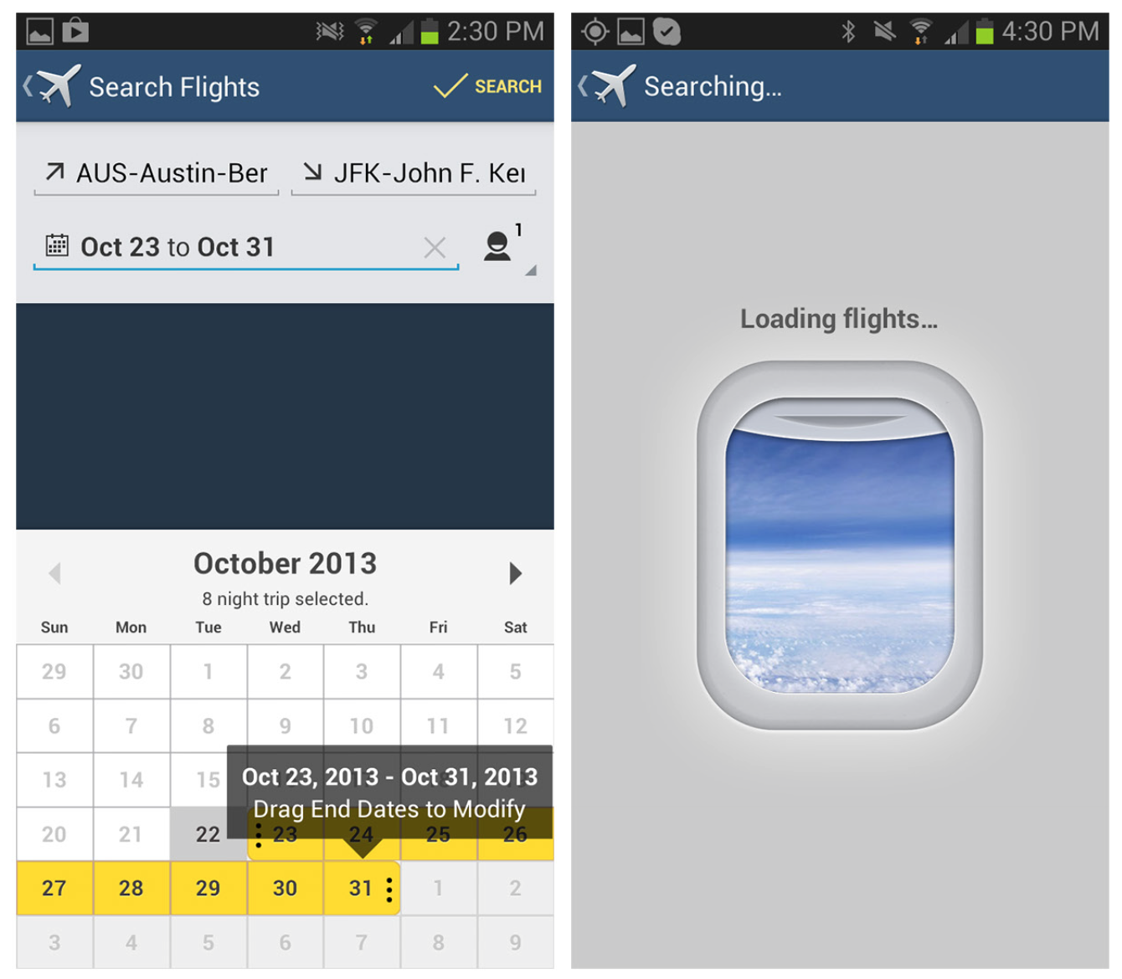

Slide 39
Search Results/View Results
Once a search is performed, the results can be displayed on the same screen or on a dedicated results screen.
Results may be displayed in a table or list, on a map or satellite image, or as thumbnails.

Slide 40
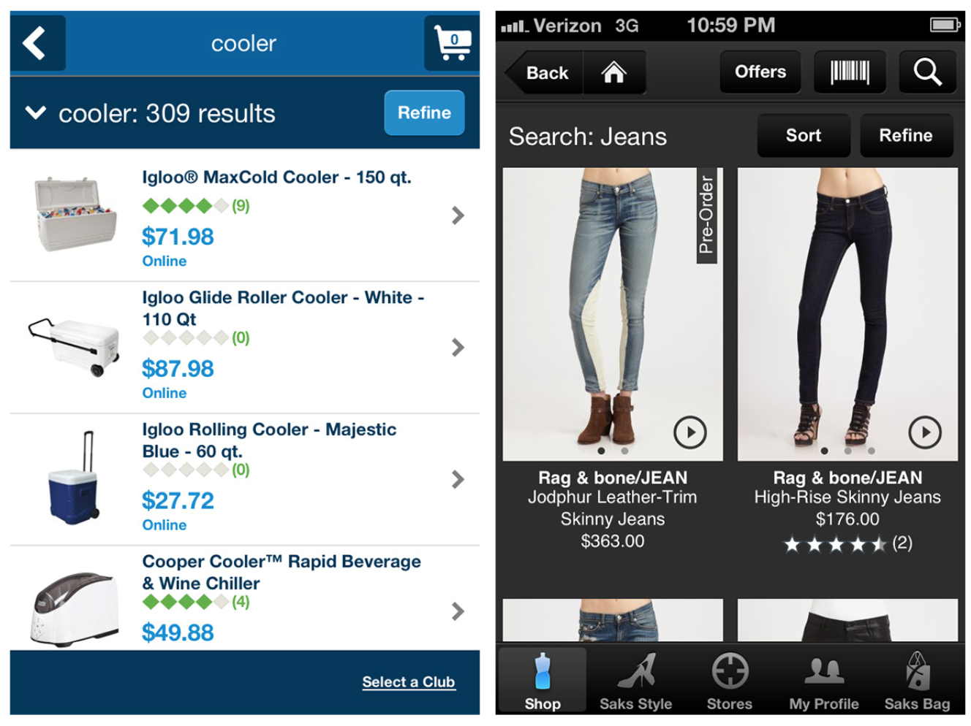
Notes:
FIGURE 4-28.
Sam’s Club and Saks for iOS: list view and tile view Search Results, respectively

Slide 41
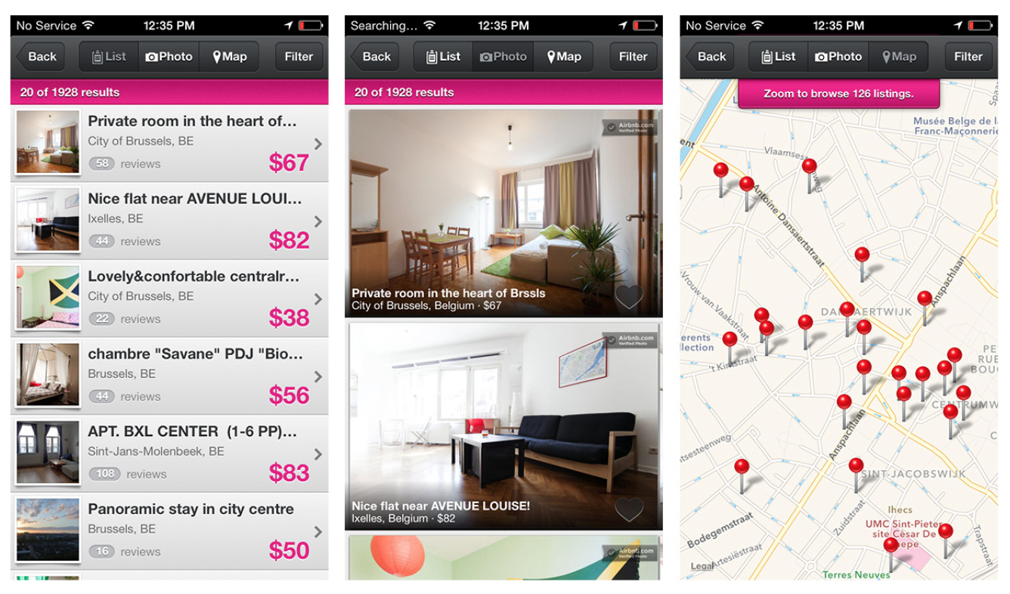
Notes:
Multiple View Results options are available depending on the type of results and user preferences .

Slide 42
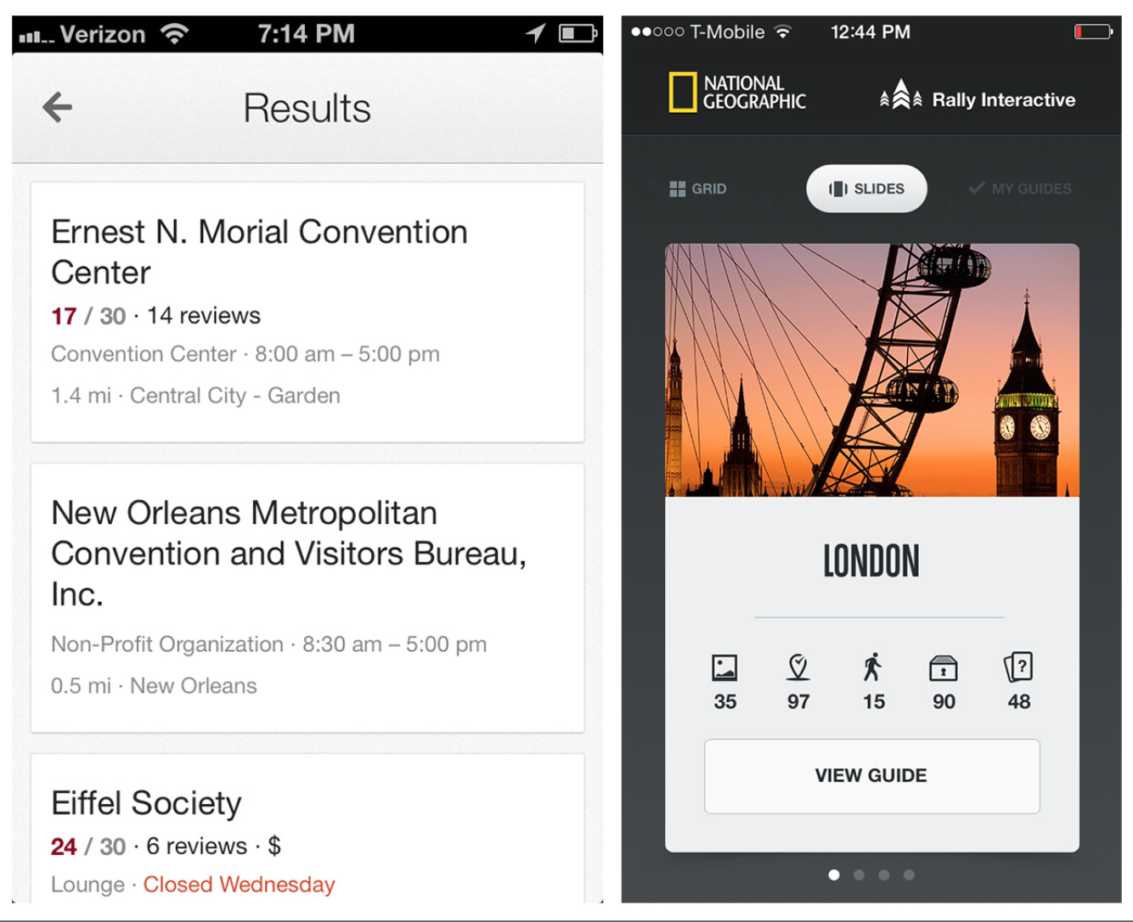
Notes:
Another emerging trend for displaying Search Results is to show each result on a card, slide, or tile.
Users can navigate these by swiping through them.
FIGURE 4-30.
Google Now’s Search Results on cards; National Geographic’s on slides

Slide 43
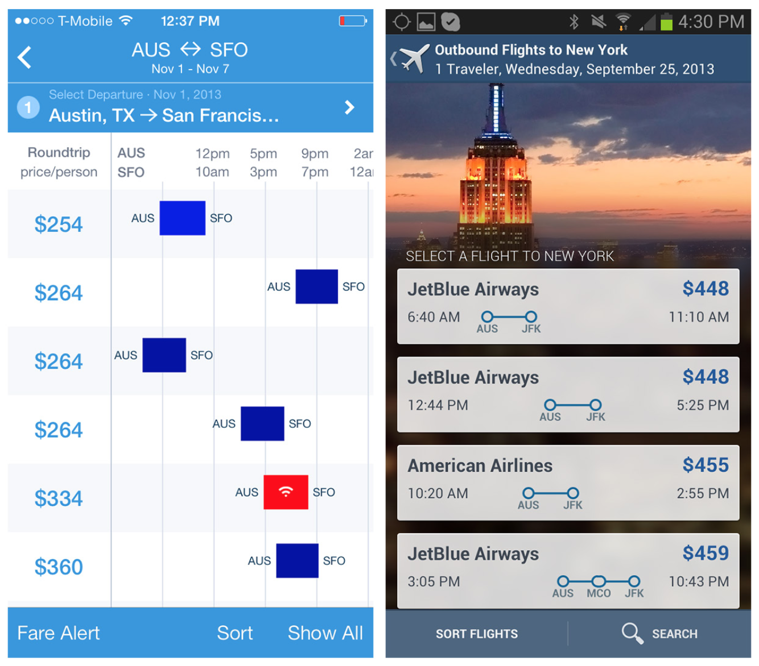
Notes:
Hipmunk has pioneered visualizing flight results with a Gantt chart– style timeline . Expedia’s take on it helps visualize the flight duration in context with the ticket cost and departure time.
Hipmunk also offers an alternative way to view hotel search results.
FIGURE 4-31.
hipmunk for iOS and Expedia for Android

Slide 44
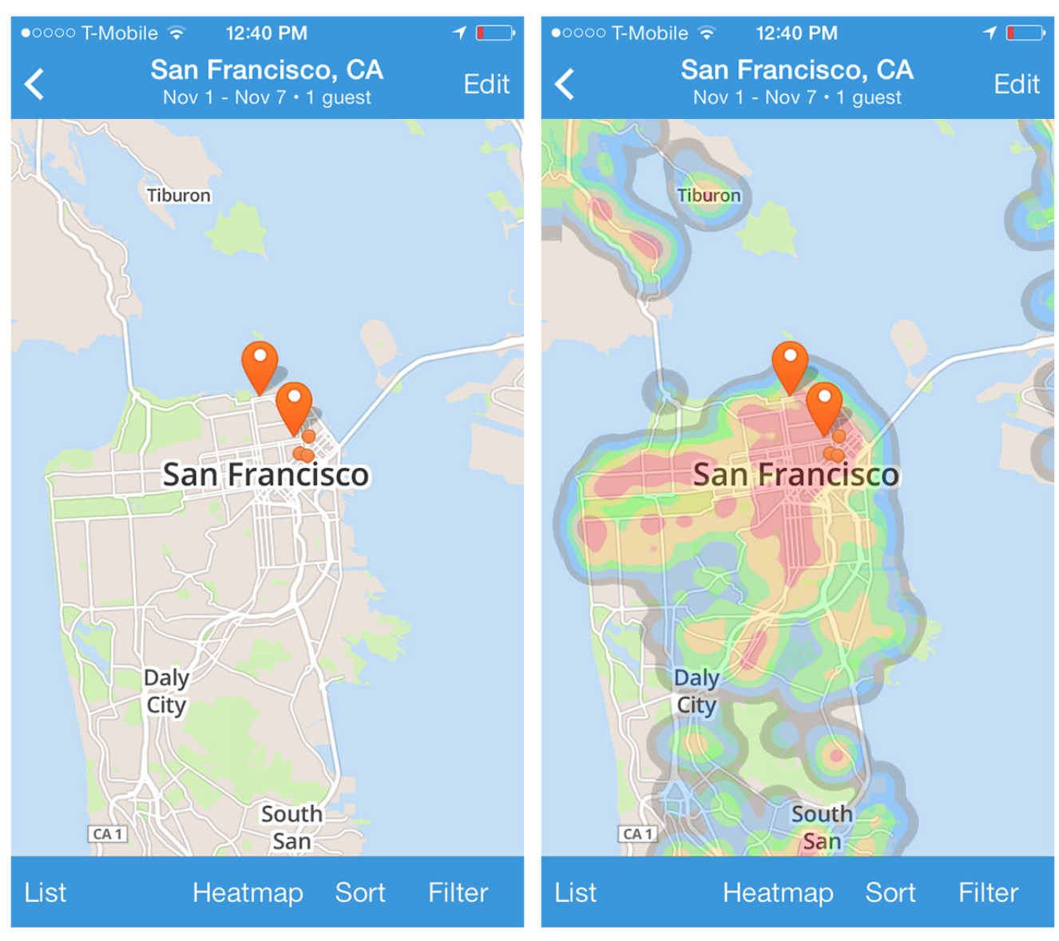
Notes:
FIGURE 4-32.
hipmunk for iOS: showing a heat map overlay for various statistics
The results are shown on a map—pretty standard, right? But there’s a heat map overlay option for viewing the hotels with respect to area crime, shopping, and nightlife.

Slide 45
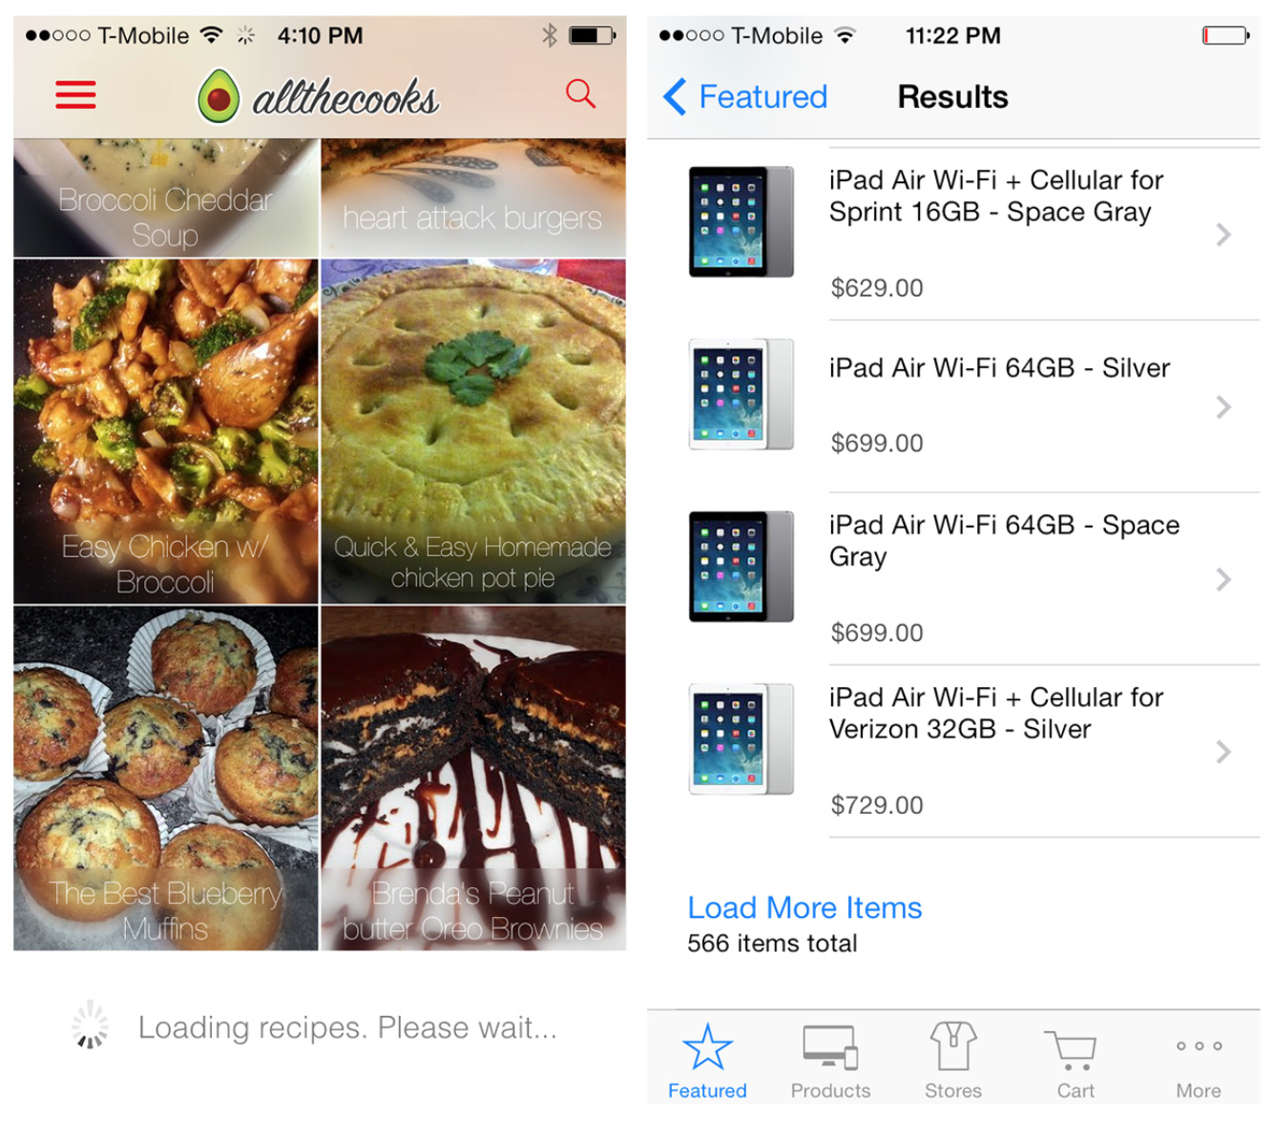
Notes:
Lazy loading is a common technique for displaying partial results while the rest are being loaded.
Many applications, like Allthecooks, automatically load more results when the screen is swiped.
Alternatively, the Apple Store provides a link to load more items.
FIGURE 4-33.
Allthecooks and Apple Store for iOS: lazy loading of results

Slide 46
Sort Patterns
Apple earns praise for some of its user-centric designs, but I’d argue the App Store search function shouldn’t be one of them.
Search “finance,” for example, and you’ll get 2,200+ results. As you start flicking through hundreds of apps, you might wonder, are these in any kind of order, like most popular, highest rated, or recently released? There’s no way to tell.
Odds are good you’ll need to go elsewhere to research which financial apps will work best for you, and then search for those specific app names.

Slide 47
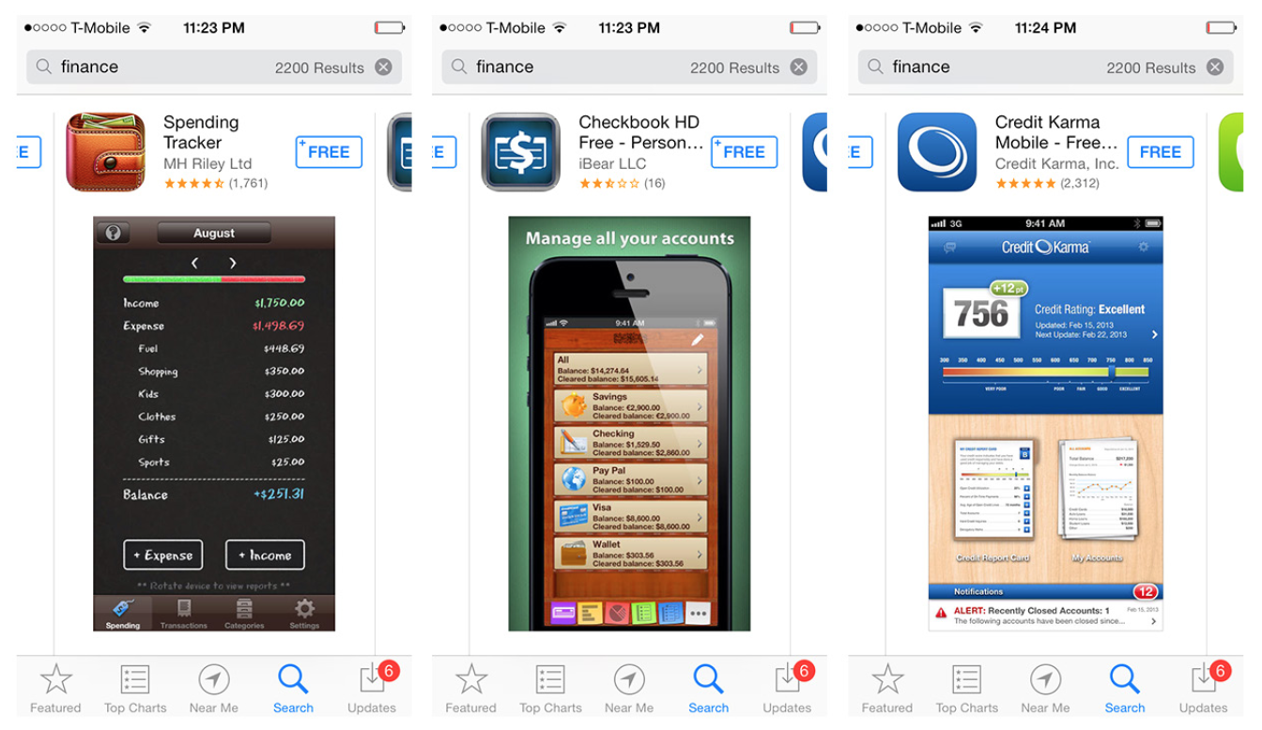
Notes:
FIGURE 4-34.
App Store for iOS: 2,200 unsorted results for finance apps

Slide 48
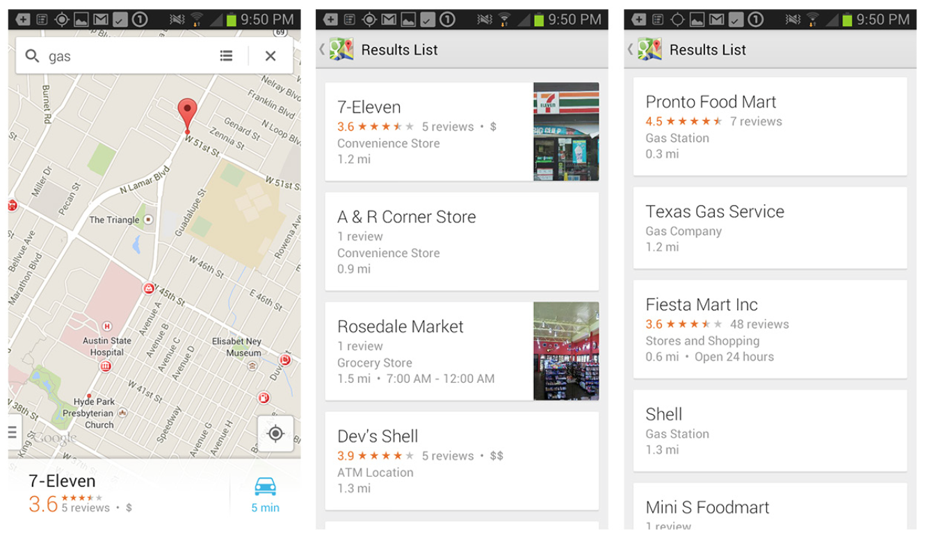
Notes:
Likewise, having the ability to manipulate search results in Google Maps would be a huge help.
I assumed the default result for “gas,” say, would be the gas station closest to my current location, but I found that typically it isn’t.
Instead, I’m forced to open the results list to check the distances of each result . Of course, even this is less than perfect, because distance and drive time are not the same thing. Having the ability to arrange the list by highest rated, distance, or drive time would be super useful . Alas, no such luck.
FIGURE 4-35.
Google Maps for Android: the closest and highest-rated result is hidden on page 2 (Pronto Food Mart)

Slide 49
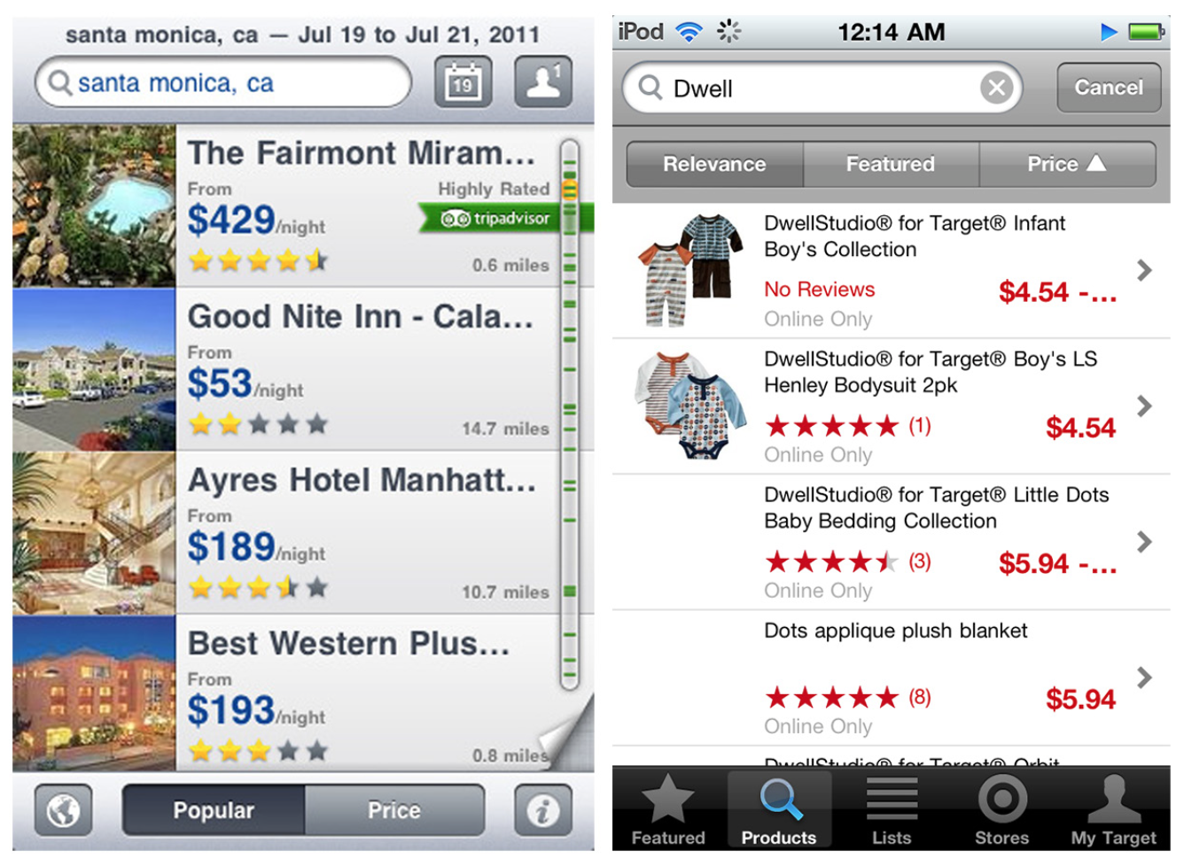
Notes:
Onscreen Sort
When you need only a few sort options, an Onscreen Sort can provide a simple one-tap solution.
But as we’ll see, many iOS apps have moved away from this pattern in favor of a more space-saving option, like the Sort Overlay.
FIGURE 4-36.
Onscreen Sort examples from the first edition of this book: Expedia and Target for iOS

Slide 50
Sort Overlay
The Sort Overlay pattern is a good alternative to Onscreen Sort.
It doesn’t take up valuable screen real estate or force a truncated label when a longer, more explicit one would work better.
The user can initiate the overlay by tapping a sort label or icon, and it can be placed at the top, middle, or bottom of the results screen.

Slide 51
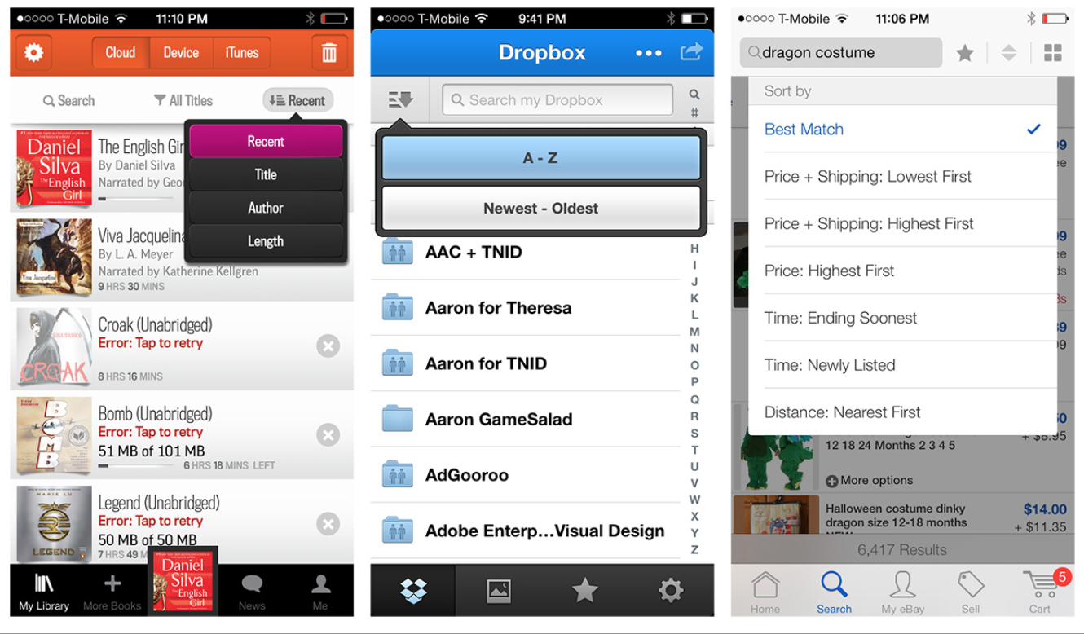
Sort Overlay
Notes:
Audible’s design is one of the most helpful since it shows which sort option is active, even when the overlay is closed .
FIGURE 4-39.
Audible, Dropbox, and eBay for iOS: top-sort overlays

Slide 52
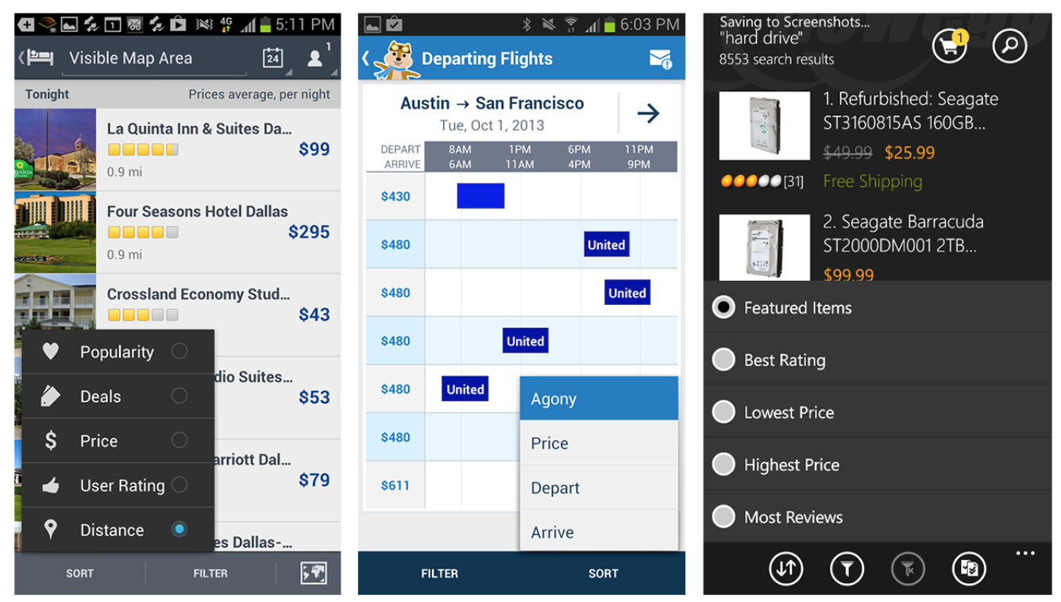
Notes:
FIGURE 4-40.
Expedia and hipmunk for Android, and Newegg for Windows Phone: bottom-sort overlays

Slide 53
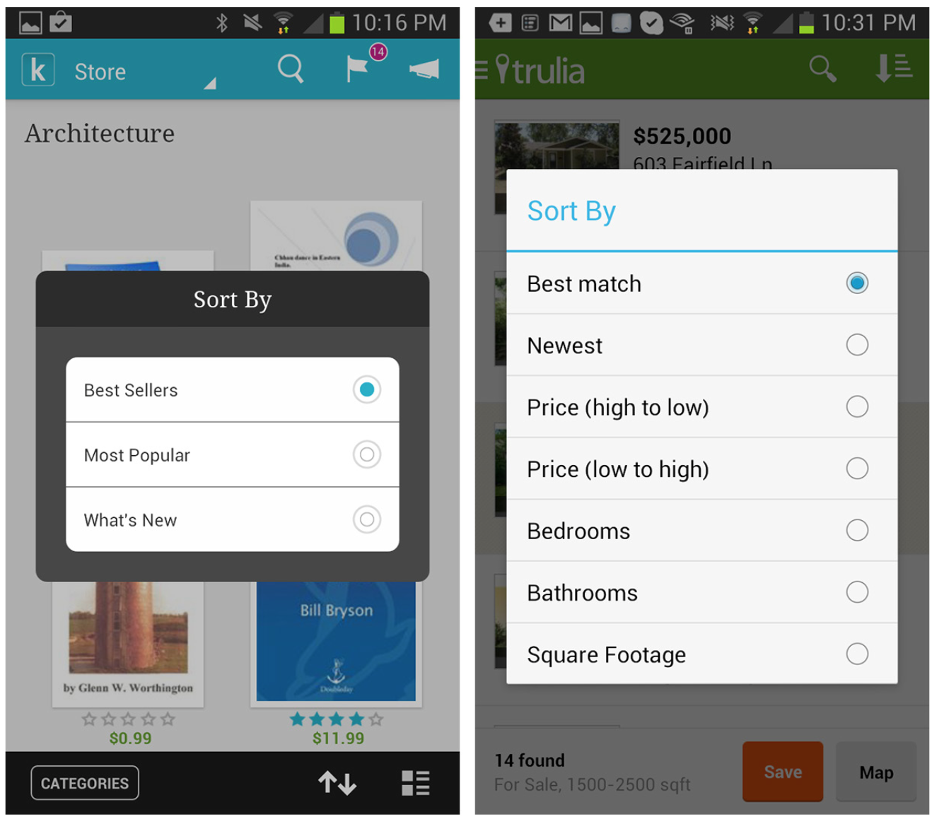
Notes:
FIGURE 4-41.
Kobo and Trulia for Android: Sort Overlay dialogs

Slide 54
Sort Form
The Sort Form may require more effort from the user, who must open the form, select an option, and potentially tap “done,” “apply,” or “back .”

Slide 55
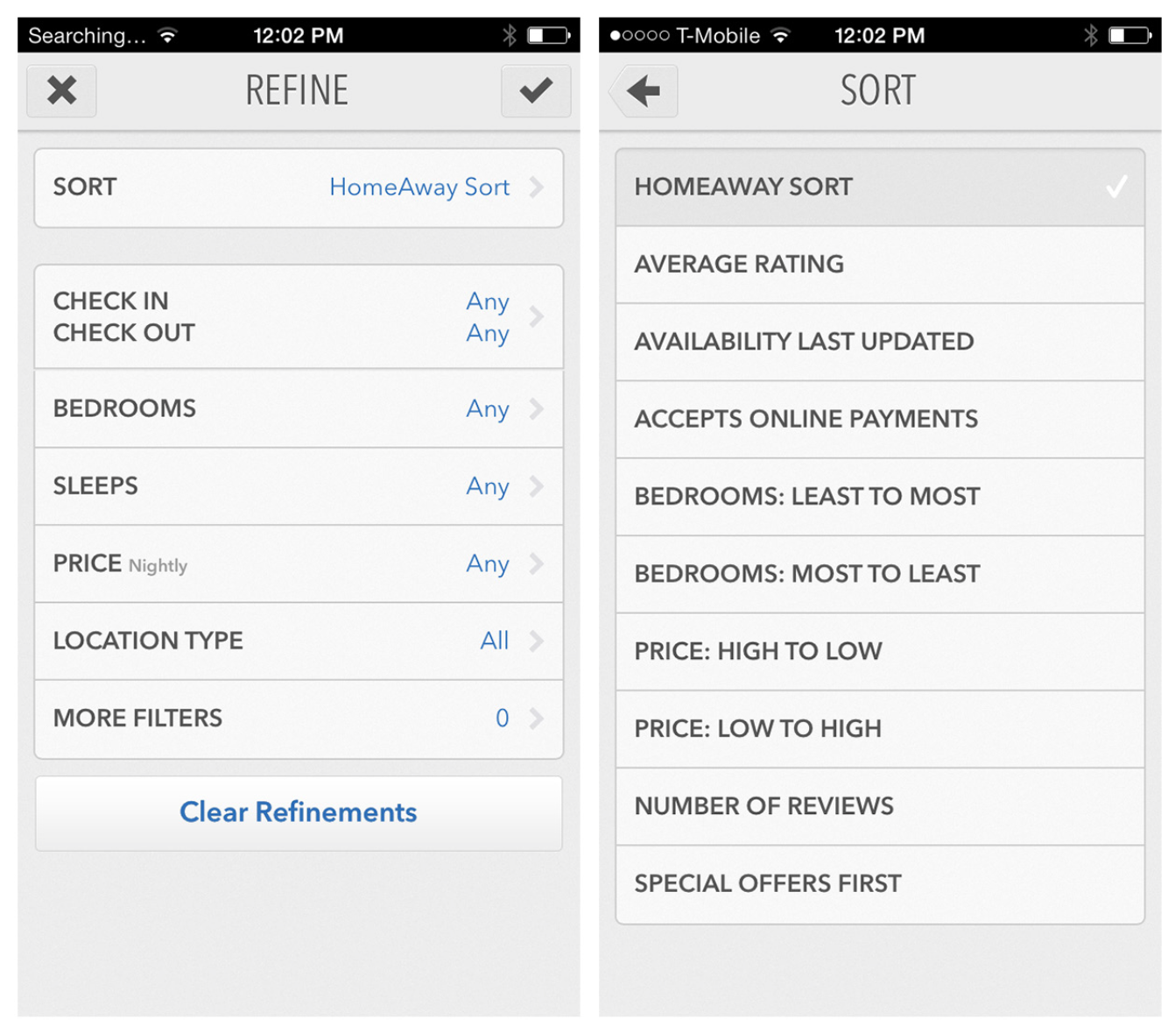
Sort Form

Slide 56
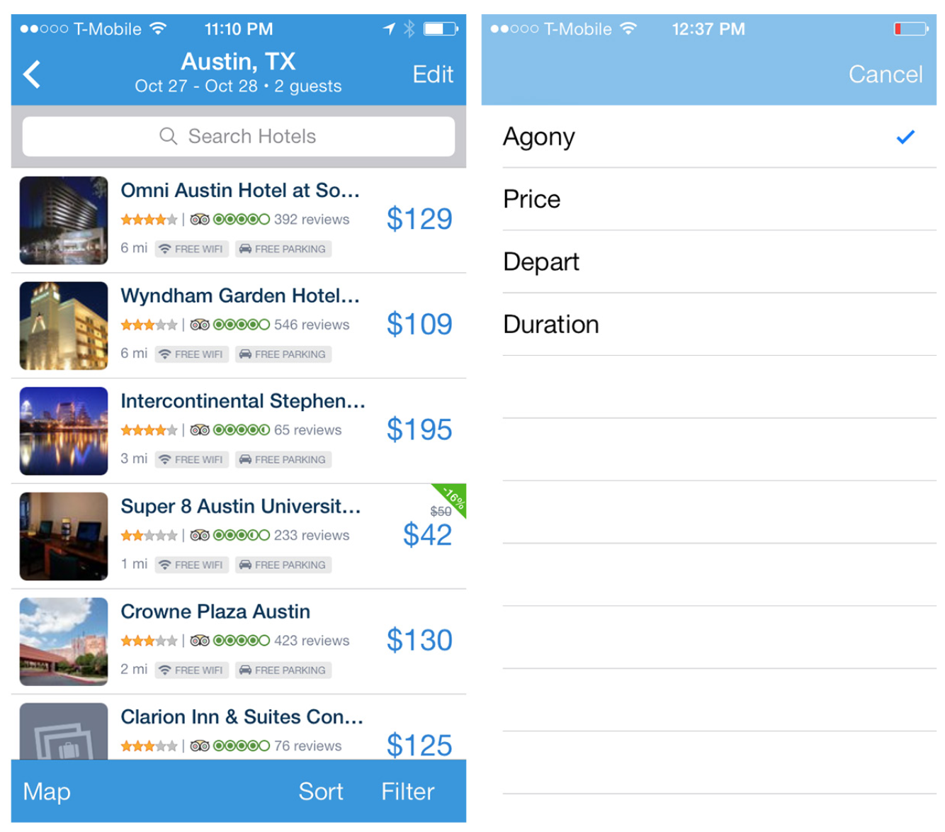
Notes:
Hipmunk uses the Sort Overlay pattern for Android, but chose a Sort Form for iOS . The sort selection is applied as soon as it is tapped—no “apply” or “done” button required .
FIGURE 4-44.
hipmunk for iOS

Slide 57
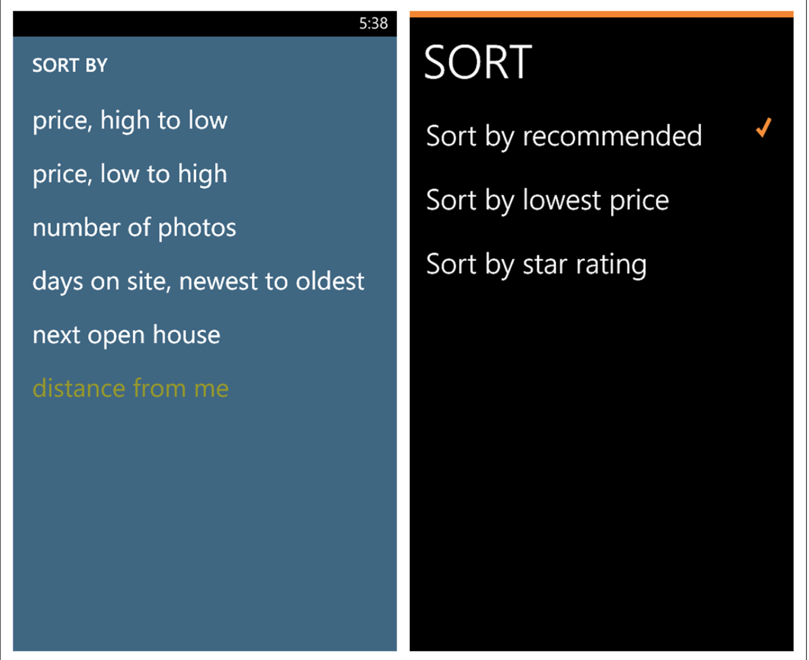
Notes:
FIGURE 4-45.
Realtor.com and Kayak for Windows Phone

Slide 58
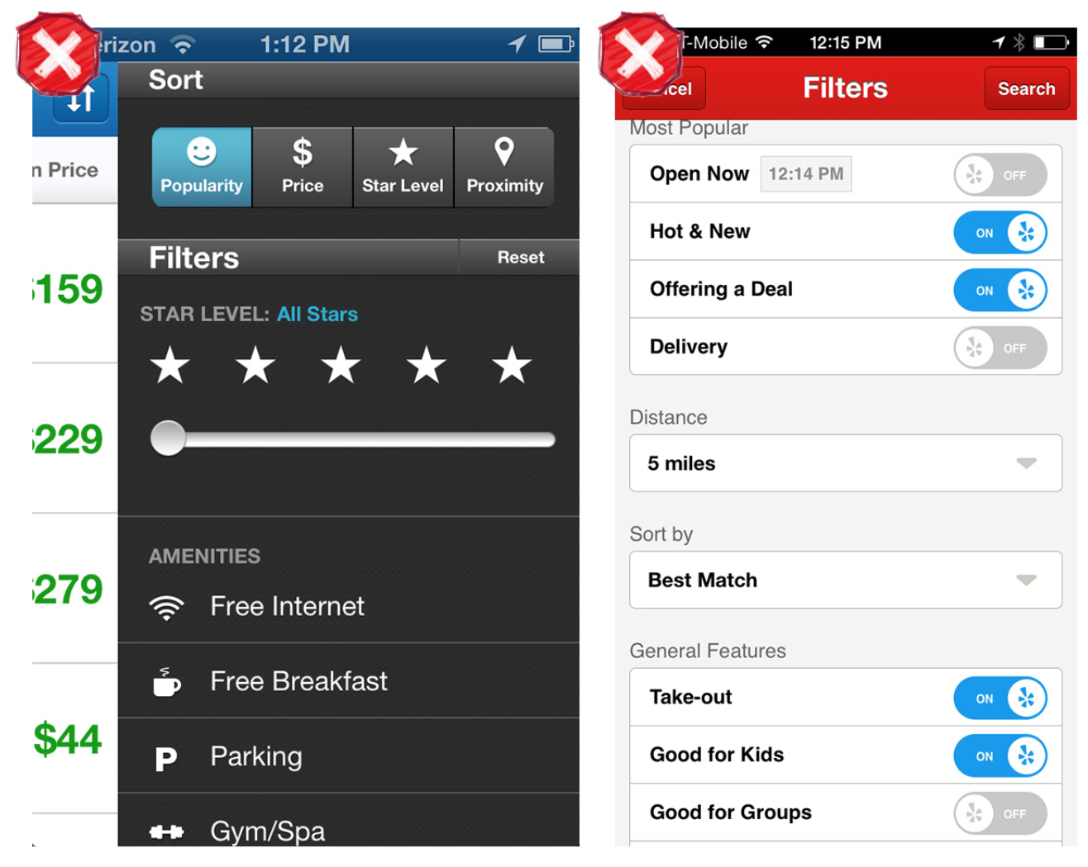
Notes:
Some apps combine sort and filter patterns in a single form . This can seem to make sense, as both are search refinement options .
But as with Priceline and Yelp for iOS, it can result in long and crowded screens that veer into anti-pattern territory (see Chapter 11) .
FIGURE 4-47.
Priceline and Yelp for iOS

Slide 59
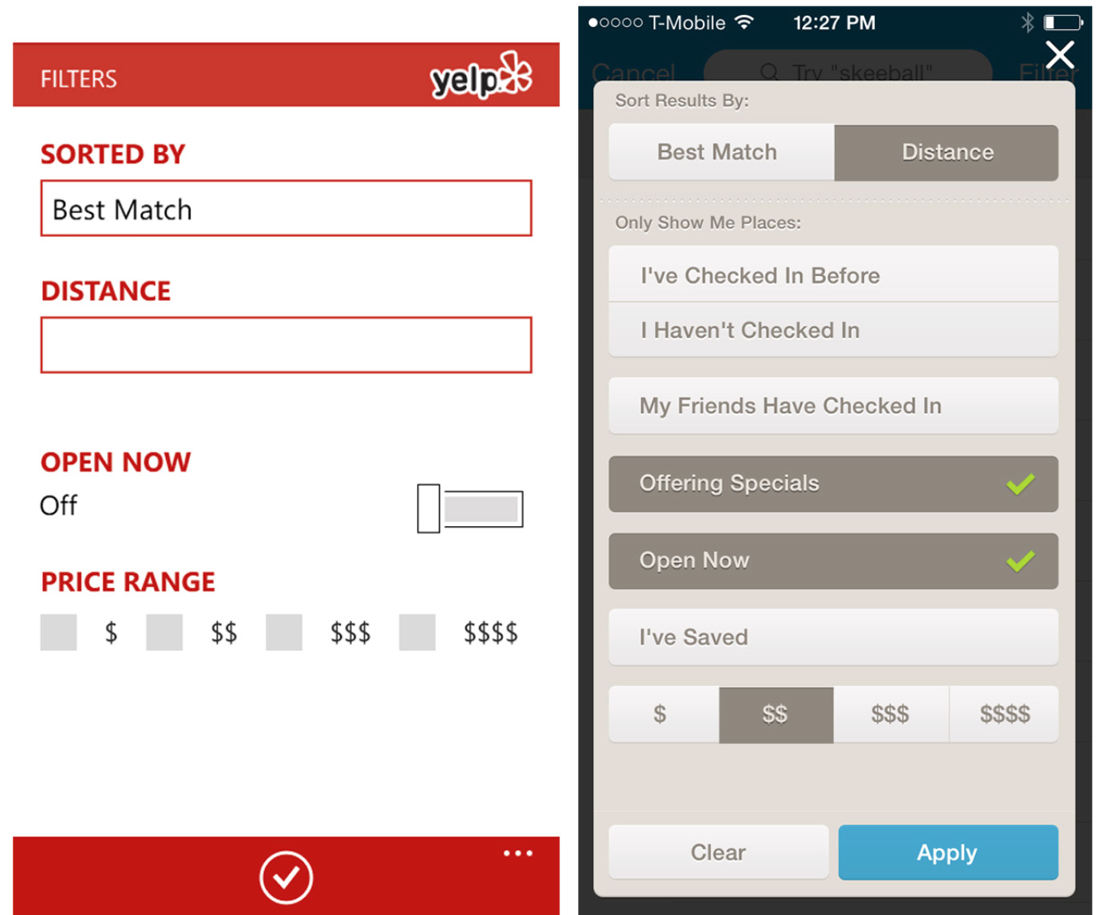
Notes:
FIGURE 4-48.
Yelp for Windows Phone and Foursquare for iOS
Yelp for Windows Phone and Foursquare for iOS offer cleaner, single-page designs .
Consider the more efficient Onscreen Sort or Sort Overlay patterns before opting for a Sort Form. If combining Sort and Filter in a single form, keep the screen as short and uncluttered as possible.

Slide 60
Filter Patterns
Large sets of data can be so unwieldy as to be almost useless.
To make sense of them, users often need to filter, or refine, the results. Filters let users select criteria to reduce data sets to their most manageable, relevant results.
Common filtering patterns include:
Onscreen Filter
FilterOverlay
FilterForm
FilterDrawer
Gesture-Based Filtering

Slide 61
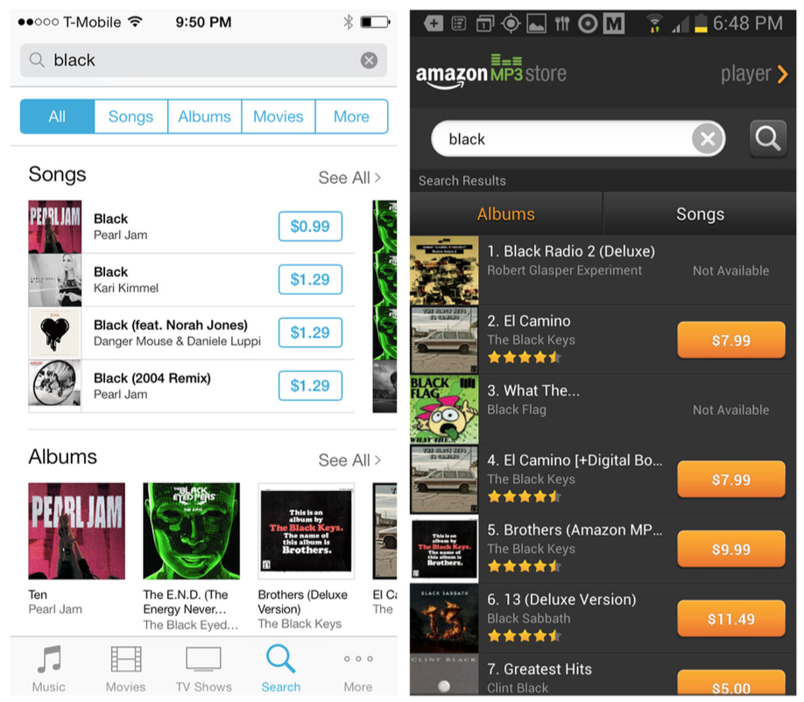
Notes:
Onscreen Filter
Like the Onscreen Sort, the Onscreen Filter is displayed on the Search Results screen. With one tap, the filter is applied.

Slide 62
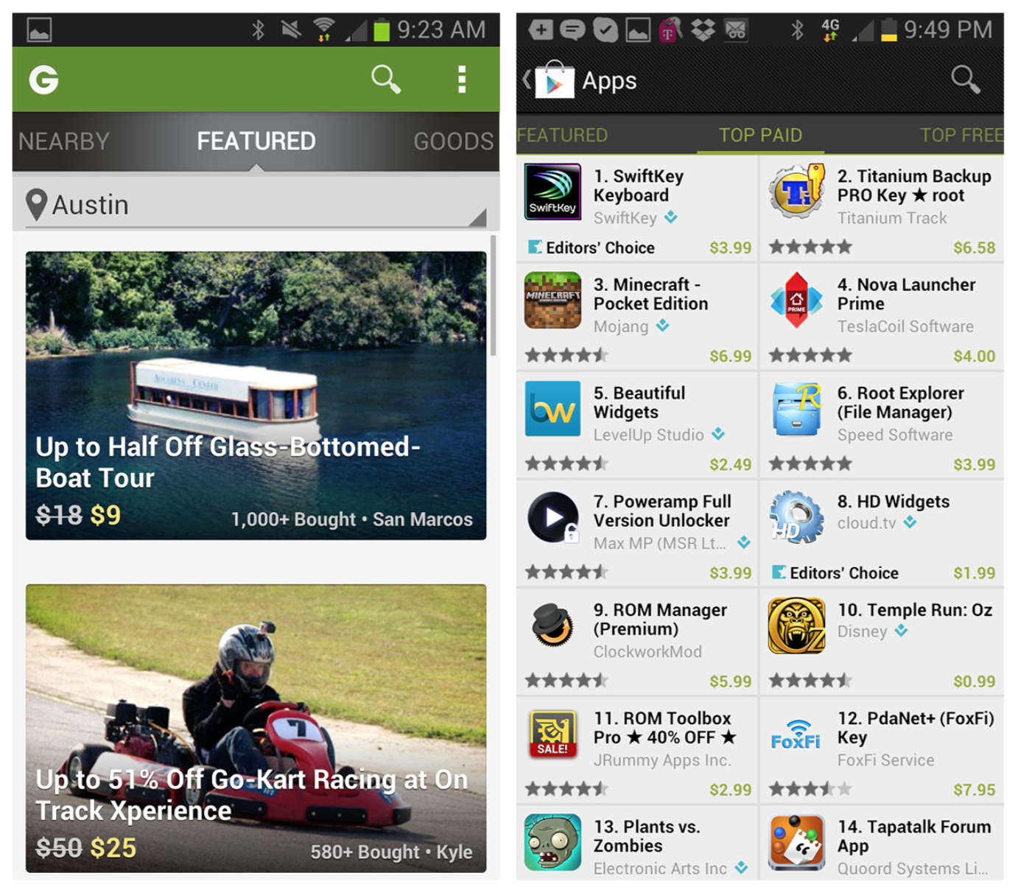
Notes:
FIGURE 4-51.
Groupon and Play Store for Android: Scrolling Tabs provide filtering

Slide 63
Filter Overlay
The Filter Overlay pattern is a viable alternative to the Onscreen Filter.
It doesn’t take up valuable screen real estate or force a short label where a longer, more explicit one would work better.
The Overlay may be initiated from a Filter or Refine label, or icons that clearly depict the filtering criteria that can be applied.

Slide 64

Notes:
FIGURE 4-54.
Airbnb for Android: Filter Overlay

Slide 65

Notes:
FIGURE 4-55.
National Parks for iOS and Expedia for Android: Filter Overlays
[ NOTE ]
Filter Overlays are useful for preserving screen real estate and including more advanced filtering options than Onscreen Filters. But they require more user time and effort, so consider the trade-offs before choosing this pattern

Slide 66


Slide 67

Notes:
FIGURE 4-56.
Ness for iOS: Filter Overlays for each filtering option

Slide 68
Filter Form
The Filter Form also requires more effort from the user, who must open the form, select one or more options, and explicitly “apply” them.
Filter Forms might be the best fit where you have a large number of filter options that lend themselves to being grouped visually.

Slide 69

Notes:
By necessity, Filter Forms momentarily hide the results being acted on . Note how Zillow for iOS dynamically updates the number of results as selections are made—this helps the user determine when the results list is manageable .
The Filter Form also works well for nested, or hierarchal, selections, as illustrated in the Walmart app for iOS 7 .
FIGURE 4-57.
Airbnb for iOS, Skyscanner for Windows Phone, and Zillow for iOS 7: Filter Forms

Slide 70

Notes:
The Filter Form also works well for nested, or hierarchal, selections, as illustrated in the Walmart app for iOS 7 .

Slide 71

Notes:
FIGURE 4-59.
Allrecipes for Windows Phone: Filter Form in context with search field

Slide 72
Filter Drawer
The Filter Drawer is very similar in some ways to both the Filter Overlay and the Filter Form. Like the Overlay and Form, it requires an extra tap of “apply” or “done” to get the filtered results.
Its main distinction is that it appears to slide out from the current screen, thus allowing the user to stay in context with the search results being refined. Ideally, the Filter Drawer will reveal a glimpse of the results behind it.

Slide 73

Notes:
FIGURE 4-60.
Target for iOS: Filter Drawer
In the Target app for iOS, the Filter Drawer slides down, completely obscuring the search results . Once the drawer is closed, there is no indication which filters have been applied . The only feedback that fil- tering is active is that the label “filter” is now blue .

Slide 74

Notes:
Here’s an example of a redesign that follows best practices for a Filter Drawer:
Symmetrical actions to open and close the drawer
Dynamic update of the number of search results
Search results still visible in the background
Explicit feedback when filters are applied
FIGURE 4-61.
Target for iOS: Filter Drawer, redesigned

Slide 75
Gesture-Based Filtering
Pinch, zoom, and pan gestures can be used for filtering results whose relevance is dependent on location, as on a map, chart, or graph.

Slide 76

Notes:
FIGURE 4-64.
homeAway for iOS: Gesture-Based Filtering
HomeAway for iOS shows a default view of a certain radius. Pinch–zoom in to reduce the radius and thus the results shown; pinch–zoom out to widen the radius and show more results.

Slide 77

Notes:
FIGURE 4-65.
Kayak for Windows Phone: Gesture-Based Filtering

